Slide 1
ΠΛΕ70: Ανάκτηση Πληροφορίας
Διδάσκουσα: Ευαγγελία Πιτουρά
Διάλεξη 10: Ανάλυση Συνδέσμων.

Slide 2
Τι θα δούμε σήμερα
Κεφ 21
Ανάλυση συνδέσμων (Link Analysis)
Σημασία της άγκυρας (anchor text)
PageRank
HITS (Κομβικές σελίδες και σελίδες κύρους)

Slide 3
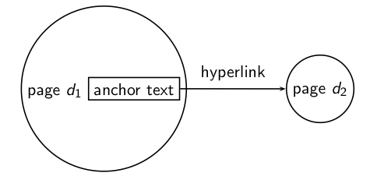
Σημασία των συνδέσεων
Κεφ 21.1
Assumption 1: A hyperlink is a quality signal.
  The hyperlink d₁ → d₂ indicates that d₁‘s author deems d₂
  high-quality and relevant.

Slide 4
Κείμενο Άγκυρας
Κεφ 21.1
  Anchor text (κείμενο άγκυρας) κείμενο που περιβάλει τον σύνδεσμο
  Example: “You can find cheap cars ˂a href =http://…˃here ˂/a ˃. ”
  Anchor text: “You can find cheap cars here”
Assumption 2: The anchor text describes the content of d₂.

Slide 5
Κείμενο Άγκυρας
Κεφ 21.1
Χρήση μόνο [text of d₂] ή [text of d₂] + [anchor text → d₂]
Αναζήτηση του [text of d₂] + [anchor text → d₂] συχνά πιο αποτελεσματική από την αναζήτηση μόνο του [text of d₂]
Παράδειγμα: Ερώτημα IBM
  Matches IBM’s copyright page
  Matches many spam pages
  Matches IBM wikipedia article
  May not match IBM home page! if IBM home page is mostly graphics

Slide 6
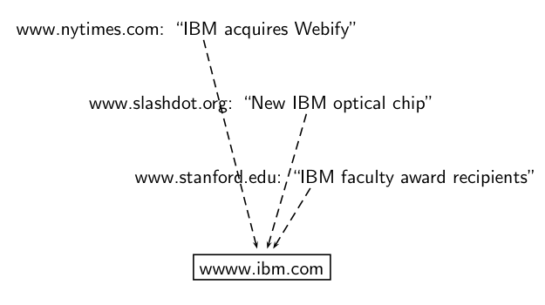
Κείμενο Άγκυρας
Κεφ 21.1
Αναζήτηση με χρήση του [anchor text → d₂] καλύτερη για το ερώτημα IBM
  Η σελίδα με τις περισσότερες εμφανίσεις του όρου IBM είναι η
  www.ibm.com
A million pieces of anchor text with “ibm” send a strong signal

Slide 7
Κείμενο Άγκυρας στο Ευρετήριο
Κεφ 21.1
Thus: Anchor text is often a better description of a page’s content than the page itself.
When indexing a document D, include (with some weight) anchor text from links pointing to D.
Armonk, NY-based computer
giant IBM announced today
www.ibm.com
Joe’s computer hardware links
Sun
HP
IBM
Big Blue today announced
record profits for the quarter

Slide 8
Google Bombs
Κεφ 21.1
Google bomb: a search with “bad” results due to maliciously manipulated anchor text.
Google introduced a new weighting function in January 2007
Can score anchor text with weight depending on the authority of the anchor page’s website
  E.g., if we were to assume that content from cnn.com or yahoo.com is authoritative, then trust the anchor text from them
Still some remnants: [dangerous cult] on Google, Bing, Yahoo
  Coordinated link creation by those who dislike the Church of Scientology
Defused Google bombs: [dumb motherf…], [who is a failure?], [evil empire] [cheerful achievement]

Slide 9


Assumption 2: annotation of target

Slide 10
Anchor Text
Κεφ. 21.1.1
Other applications
  Weighting/filtering links in the graph
  Generating page descriptions from anchor text

Slide 11
The Web as a Directed Graph
Κεφ. 21.1
Page A
Page B
hyperlink
Anchor
Assumption 1: A hyperlink between pages denotes a conferral of authority (quality signal)
Assumption 2: The text in the anchor of the hyperlink describes the target page (textual context)

Slide 12
Οι σύνδεσμοι είναι παντού!
Powerful sources of authenticity and authority
  Mail spam – which email accounts are spammers?
  Host quality – which hosts are “bad”?
  Phone call logs
The Good, The Bad and The Unknown
?
Good
?
?
Bad
?

Slide 13
Simple iterative logic
The Good, The Bad and The Unknown
  Good nodes won’t point to Bad nodes
  All other combinations plausible
?
Good
?
?
Bad
?

Slide 14
Simple iterative logic
Good nodes won’t point to Bad nodes
  If you point to a Bad node, you’re Bad
  If a Good node points to you, you’re Good
?
Good
?
?
Bad
?

Slide 15
Simple iterative logic
Good nodes won’t point to Bad nodes
  If you point to a Bad node, you’re Bad
  If a Good node points to you, you’re Good
Good
?
Bad
?

Slide 16
Simple iterative logic
Good nodes won’t point to Bad nodes
  If you point to a Bad node, you’re Bad
  If a Good node points to you, you’re Good
Good
?
Bad

Slide 17
Many other examples of link analysis
Social networks are a rich source of grouping behavior
E.g., Shoppers’ affinity – Goel+Goldstein 2010
  Consumers whose friends spend a lot, spend a lot themselves
http://www.cs.cornell.edu/home/kleinber/networks-book/

Slide 18
Κεφ 21
PageRank

Slide 19
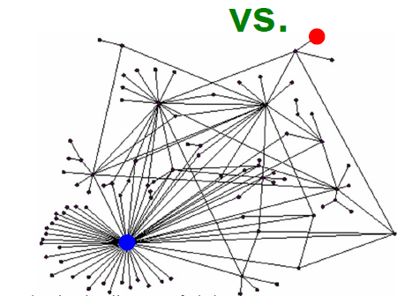
Link Analysis
Κεφ. 21
Κεφ. 21.1
Not all web pages are equal

Slide 20
PageRank
Κεφ. 21.2
A page is important if it has many links (ingoing? outgoing?)
Are all links equal important?
A page is important if it is cited by other important pages

Slide 21
PageRank: Βασική ιδέα
Κεφ. 21.2
Κάθε σελίδα έχει ένα PageRank
Κάθε σελίδα μοιράζει το PageRank στις σελίδες που δείχνει
Το PageRank μιας σελίδας είναι το άθροισμα των PageRank των σελίδων που δείχνουν σε αυτή

Slide 22
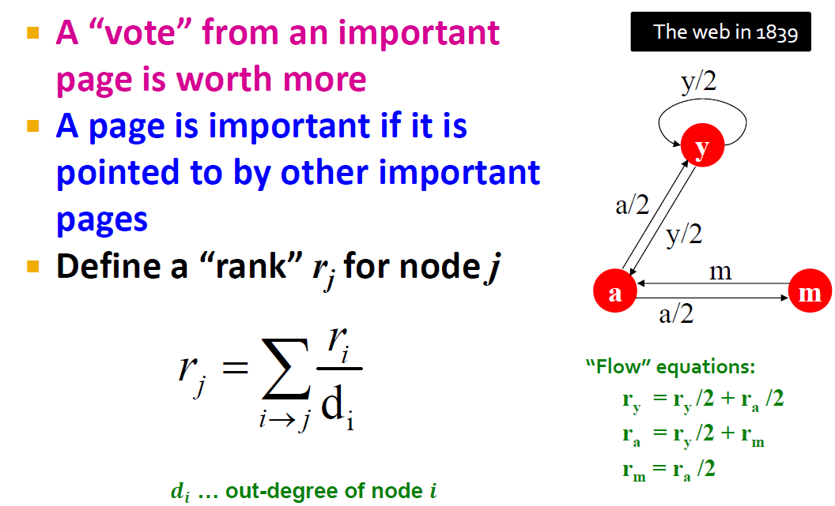
PageRank: Παράδειγμα
Κεφ. 21.2

Slide 23
PageRank: Αλγόριθμος
Κεφ. 21.2
In a network with n nodes, assign all nodes the same initial PageRank = 1/n.
Perform a sequence of k updates to the PageRank values, using the following rule:
Basic PageRank Update Rule:
Each page divides its current PageRank equally across its out-going links, and passes these equal shares to the pages it points to.
(If a page has no out-going links, it passes all its current PageRank to itself.)
Each page updates its new PageRank to be the sum of the shares it receives.

Slide 24
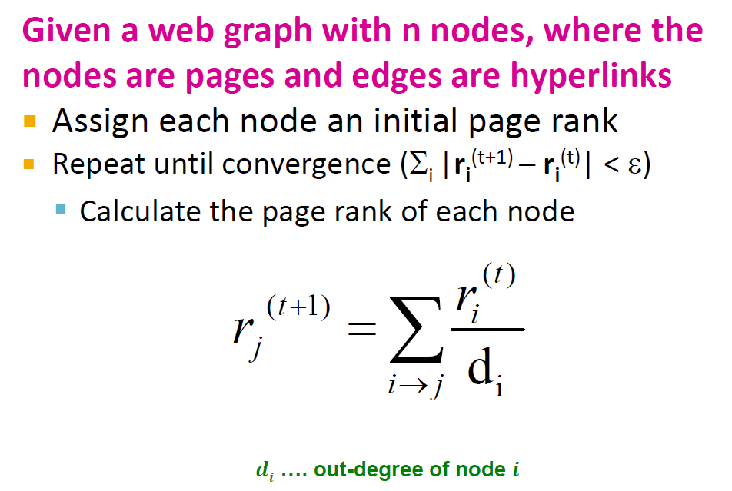
PageRank: Αλγόριθμος
Κεφ. 21.2

Slide 25
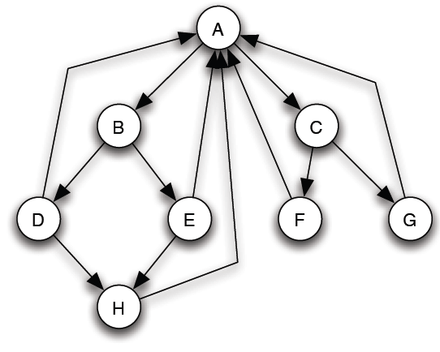
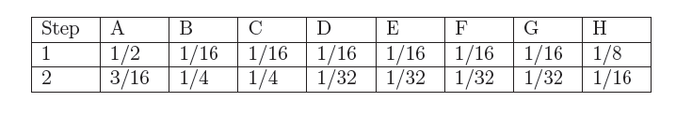
PageRank: Αλγόριθμος
Κεφ. 21.2
Initially, all nodes PageRank 1/8
As a kind of “fluid” that circulates through the network
The total PageRank in the network remains constant (no need to normalize)

Slide 26
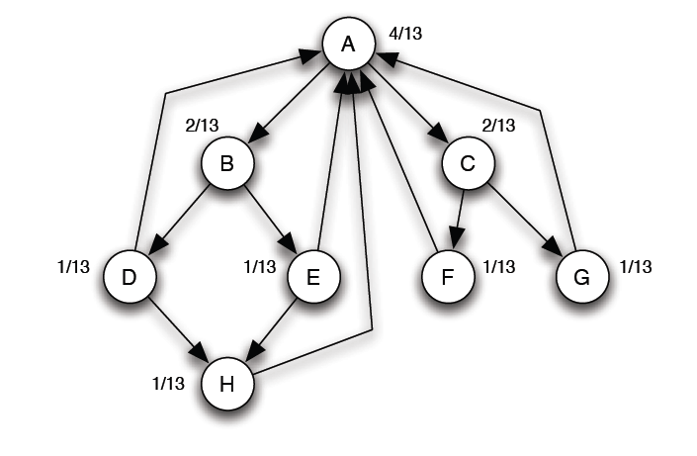
PageRank: Αλγόριθμος
Κεφ. 21.2
A simple way to check whether an assignment of numbers s forms an equilibrium set of PageRank values: check that they sum to 1, and check that when apply the Basic PageRank Update Rule, we get the same values back.
If the network is strongly connected then there is a unique set of equilibrium values.

Slide 27
PageRank: Διανυσματική αναπαράσταση
Κεφ. 21.2
Stochastic Adjacency Matrix
Πίνακας M – πίνακας γειτνίασης του web
Αν j -> i, τότε Μij = 1/outdegree(j)
Αλλιώς, Mij = 0
Page Rank Vector
Ένα διάνυσμα με μία τιμή για κάθε σελίδα (το PageRank της σελίδας)

Slide 28
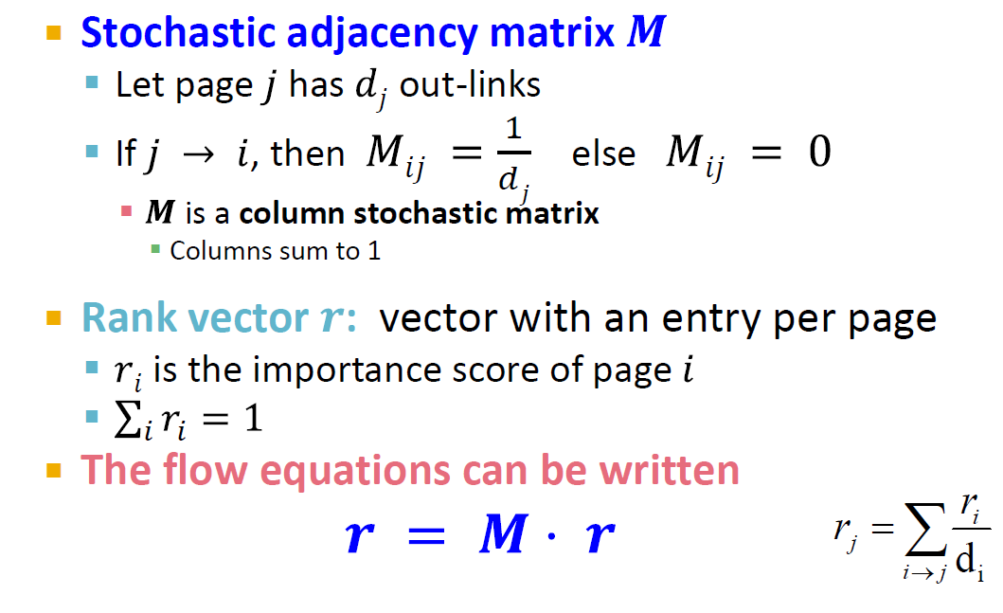
PageRank: Διανυσματική αναπαράσταση
Κεφ. 21.2

Slide 29
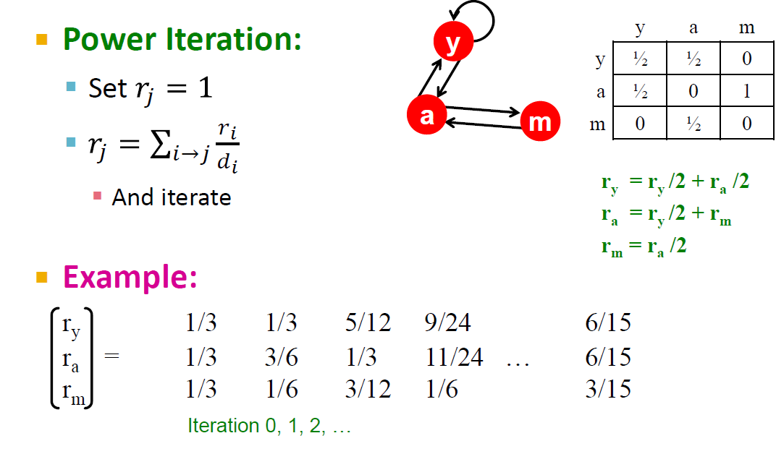
PageRank: Διανυσματική αναπαράσταση
Κεφ. 21.2

Slide 30
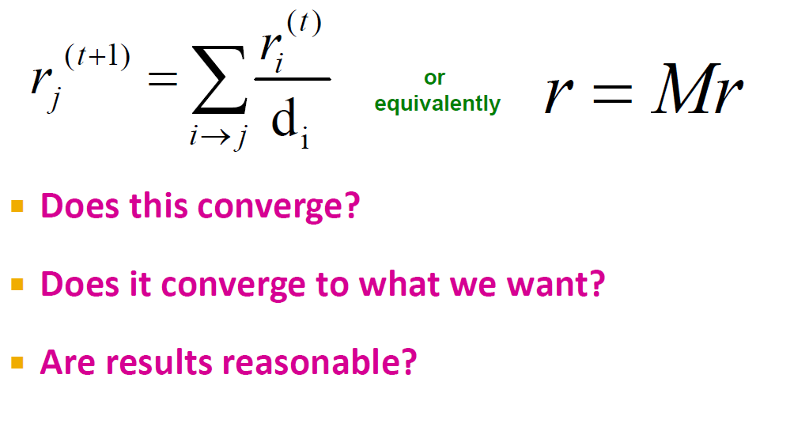
PageRank: Διανυσματική αναπαράσταση
Κεφ. 21.2

Slide 31
PageRank: Random Walks
Κεφ. 21.2
Random walk interpretation
Someone randomly browse a network of Web pages.
Starts by choosing a page at random, picking each page with equal probability.
Then follows links for a sequence of k steps: each step, picking a random out-going link from the current page, and follow it to where it leads.
Claim: The probability of being at a page X after k steps of this random walk is precisely the PageRank of X after k applications of the Basic PageRank Update Rule.

Slide 32
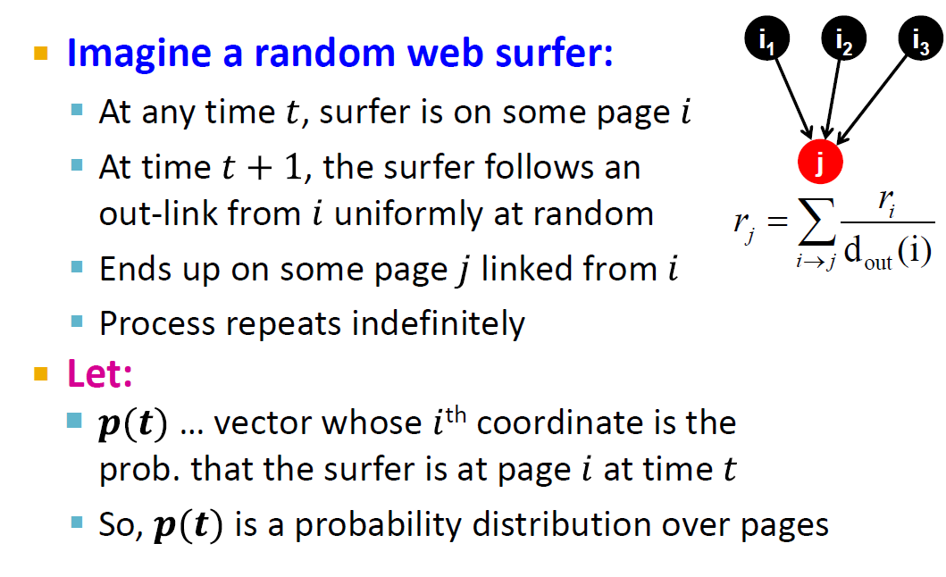
PageRank: Random Walks
Κεφ. 21.2

Slide 33
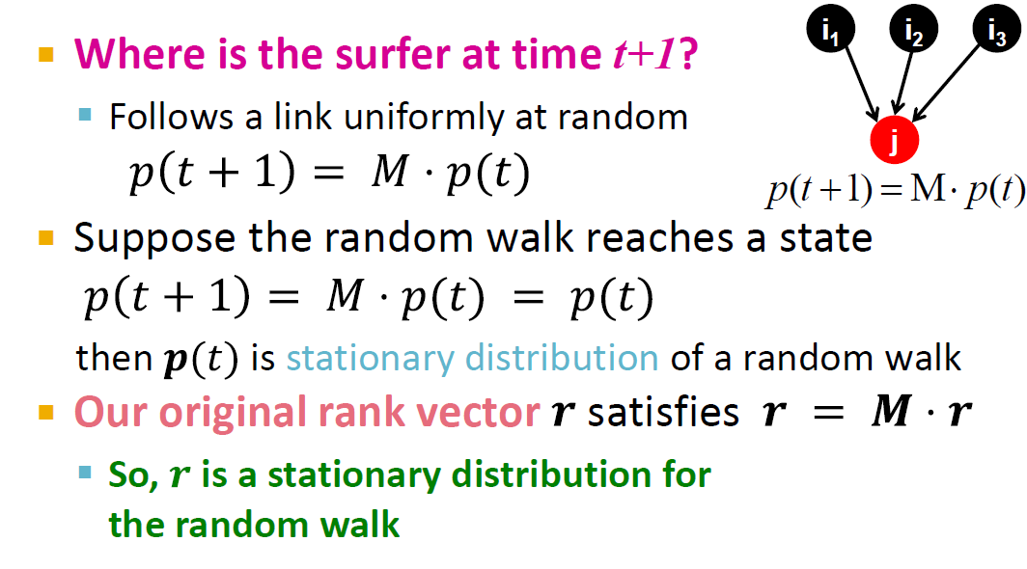
PageRank: Random Walks
Κεφ. 21.2

Slide 34
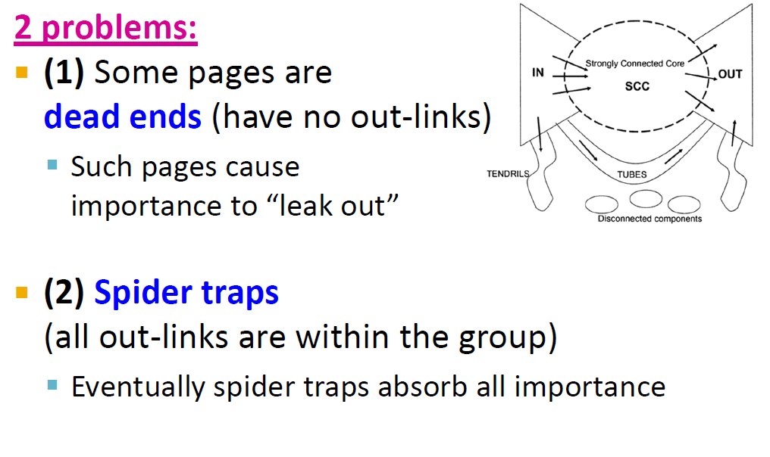
PageRank: Extensions
Κεφ. 21.2

Slide 35
PageRank: Αδιέξοδα
Κεφ. 21.2
Αδιέξοδα (dead ends): σελίδες που δεν έχουν outlinks
??
Random walk can get stuck in dead-ends

Slide 36
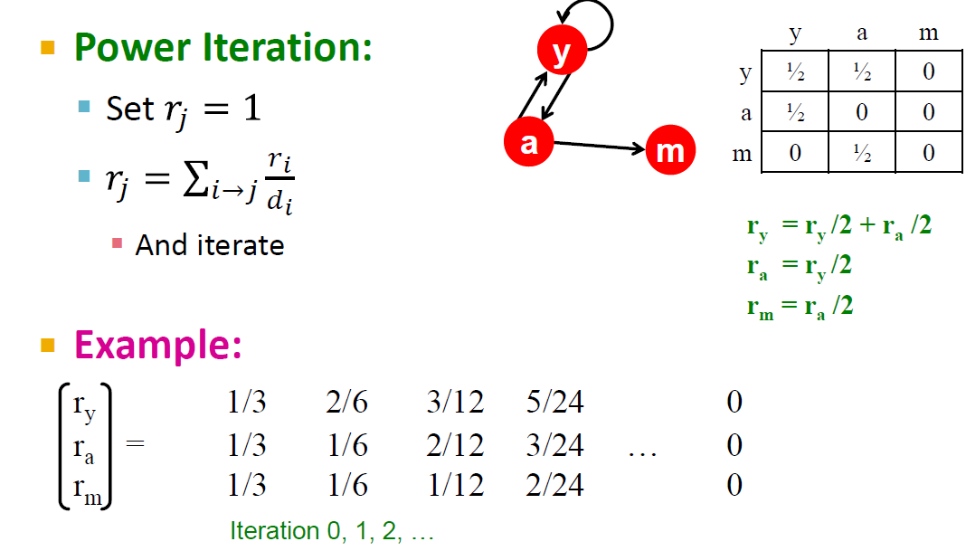
PageRank: Αδιέξοδα
Κεφ. 21.2

Slide 37
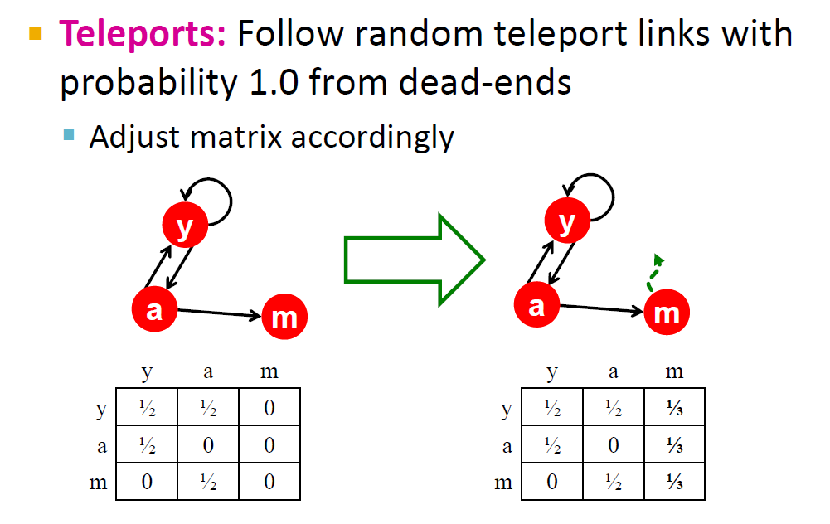
PageRank: Αδιέξοδα
Κεφ. 21.2

Slide 38
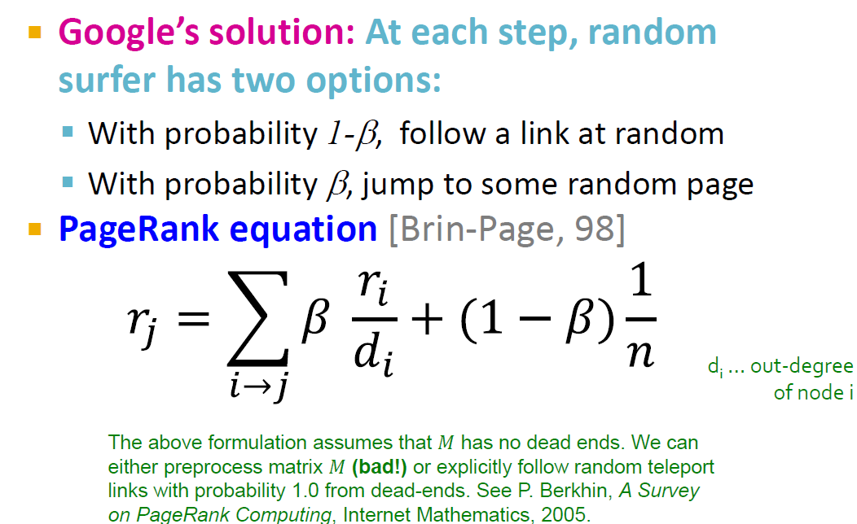
PageRank: Αδιέξοδα
Κεφ. 21.2

Slide 39
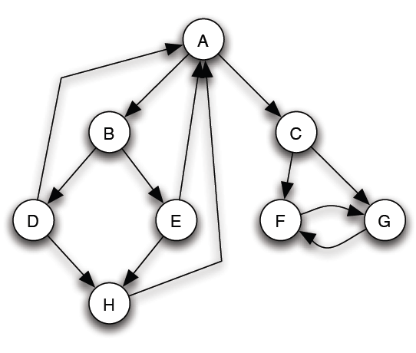
PageRank: Spider Traps
Κεφ. 21.2

Slide 40
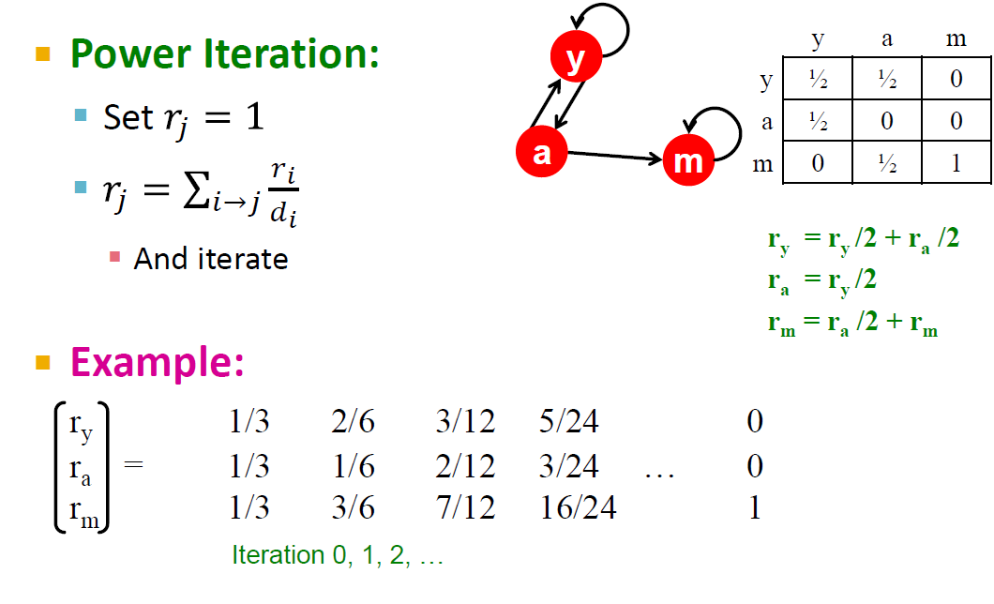
PageRank: Spider Traps
Κεφ. 21.2

Slide 41
PageRank: Spider Traps
Κεφ. 21.2
Scaled PageRank Update Rule:
First apply the Basic PageRank Update Rule.
Then scale down all PageRank values by a factor of s. This means that the total PageRank in the network has shrunk from 1 to s.
Divide the residual 1 − s units of PageRank equally over all nodes, giving (1 − s)/n to each.

Slide 42
PageRank: Spider Traps
Κεφ. 21.2
Random walk with jumps
With probability s, the walker follows a random edge as before; and with probability 1 − s, the walker jumps to a random page anywhere in the network, choosing each node with equal probability

Slide 43
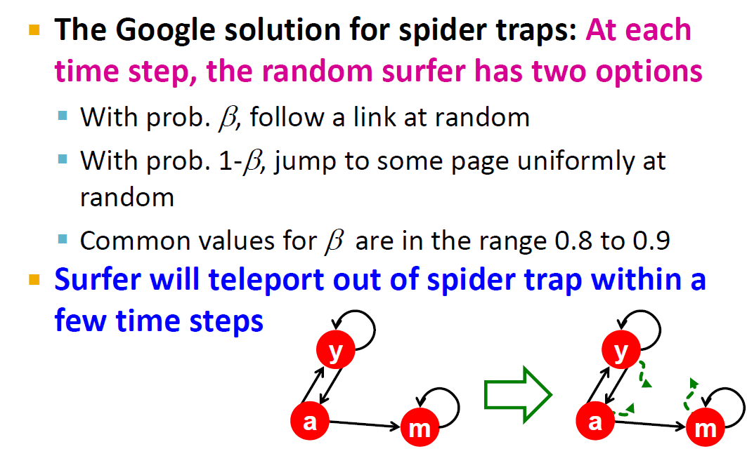
PageRank: Spider Traps
Κεφ. 21.2

Slide 44
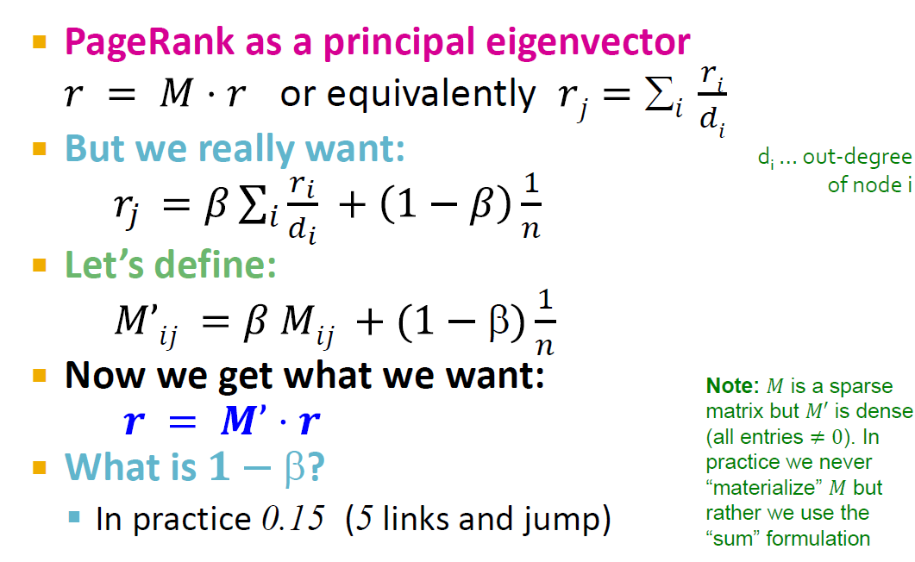
PageRank: Spectral Analysis
Κεφ. 21.2

Slide 45
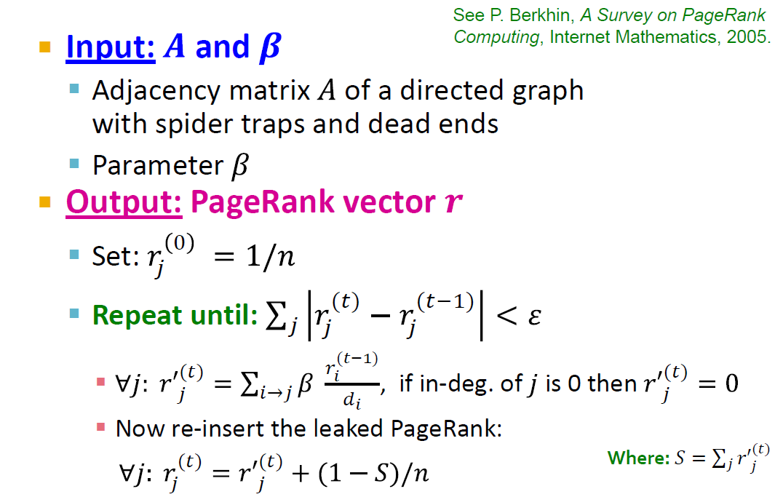
PageRank: Spectral Analysis
Κεφ. 21.2

Slide 46
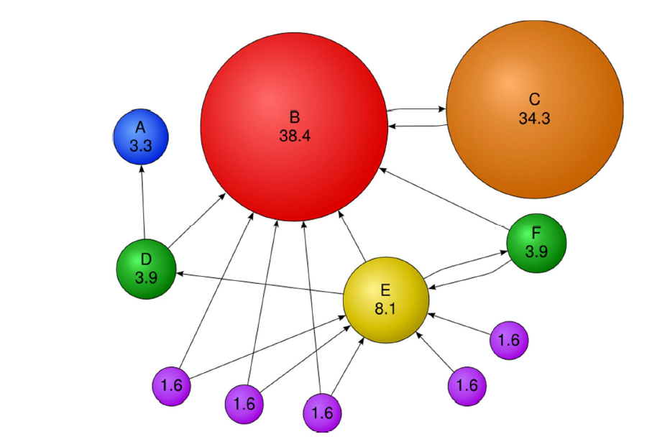
PageRank: Example
Κεφ. 21.2

Slide 47
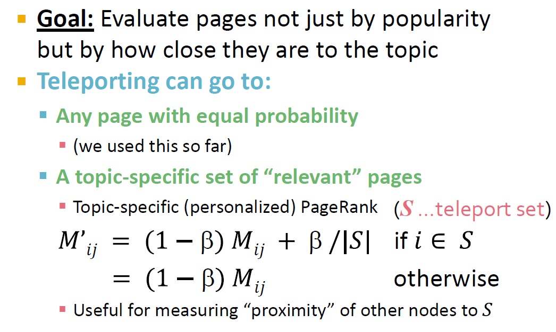
Personalized PageRank
Κεφ. 21.2

Slide 48
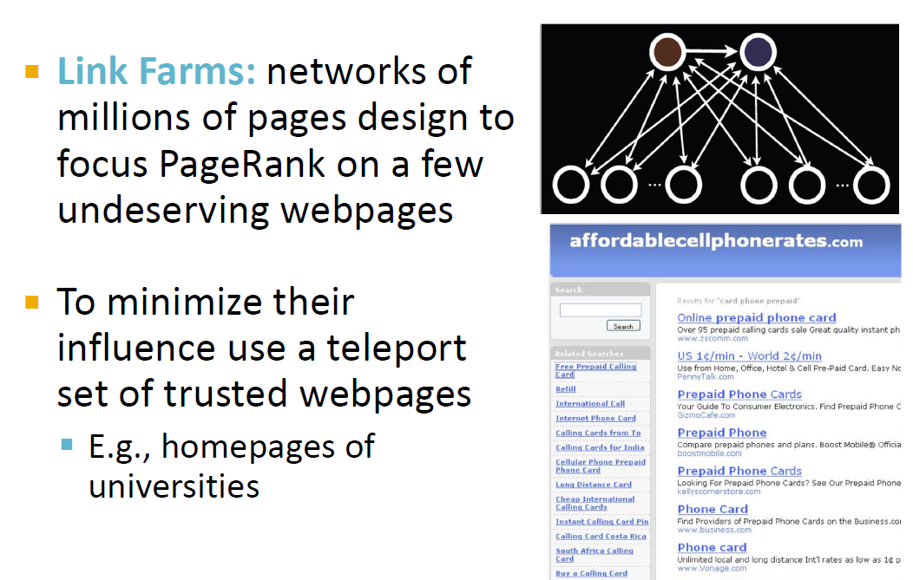
PageRank: Trust Rank
Κεφ. 21.2

Slide 49
Pagerank summary
Κεφ. 21.2.2
Preprocessing:
  Given graph of links, build matrix P.
  From it compute a – left eigenvector of P.
  The entry a_{i} is a number between 0 and 1: the pagerank of page i.
Query processing:
  Retrieve pages meeting query.
  Rank them by their pagerank.
  But this rank order is query-independent …

Slide 50
The reality
Pagerank is used in google and other engines, but is hardly the full story of ranking
  Many sophisticated features are used
  Some address specific query classes
  Machine learned ranking (Lecture 19) heavily used
Pagerank still very useful for things like crawl policy

Slide 51
Κεφ 21
HITS

Slide 52
HITS
Κεφ. 21.3
Δύο βασικές διαφορές
Κάθε σελίδα έχει δύο βαθμούς:
  ένα βαθμό κύρους (authority rank) και
  ένα κομβικό βαθμό (hub rank)
Οι βαθμοί είναι θεματικοί

Slide 53
HITS: βασική ιδέα
Κεφ. 21.3
Ας πούμε ότι ψάχνουμε για εφημερίδες (keyword: newspaper)
First collect a large number of pages that are relevant to the topic (e.g., using text-only IR)
The pages may not be actual web sites of a “newspaper” but we can use them to access the “authority” of a page on the topic
How?
  Relevant pages “vote” through their links
  Authority = #in-links from relevant pages

Slide 54
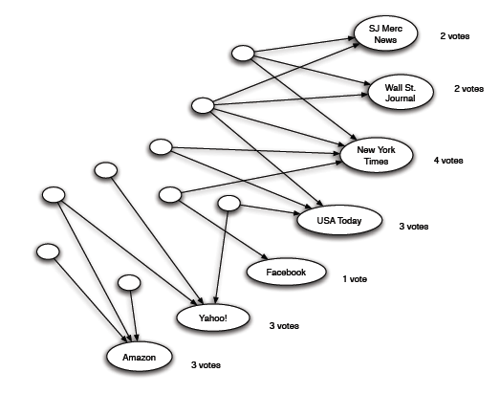
HITS: βασική ιδέα
Κεφ. 21.3
Relevant pages
“quality” of relevant pages?
Best – pages that compile lists of resources relevant to the topic (hubs)

Slide 55
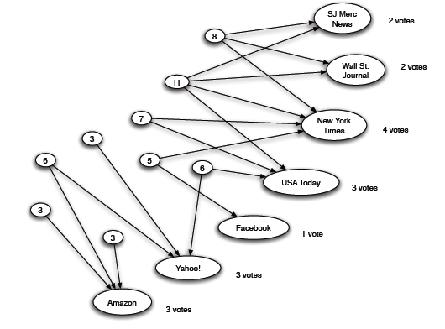
HITS: βασική ιδέα
Κεφ. 21.3
the principle of repeated improvement
Hubs:
Voted for many of the pages
value of a hub = sum of the votes received by all pages it voted for

Slide 56
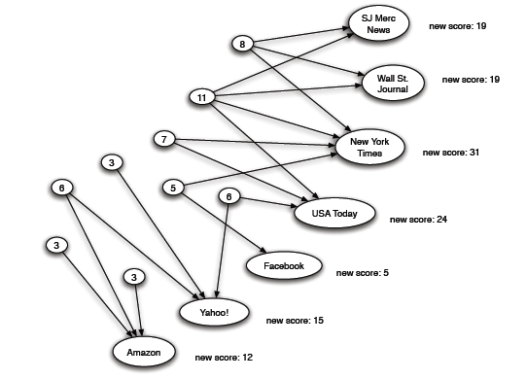
HITS: βασική ιδέα
Κεφ. 21.3
Vote (link) from a good “hub” should count more!
Think about restaurant recommendations!!

Slide 57
HITS: βασική ιδέα
Κεφ. 21.3
the principle of repeated improvement
Why stop here?
Recompute the score of the hubs using the improved scores of the authorities!
Repeat .. Recompute the score of the authories using the improved scores of the hubs!
…

Slide 58
HITS
Κεφ. 21.3
Interesting pages fall into two classes:
Authorities: pages containing useful information (the prominent, highly endorsed answers to the queries)
Newspaper home pages
  Course home pages
    Home pages of auto manufacturers
Hubs: pages that link to authorities (highly value lists)
List of newspapers
Course bulletin
List of US auto manufacturers
A good hub links to many good authorities
A good authority is linked from many good hubs

Slide 59
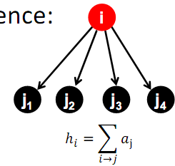
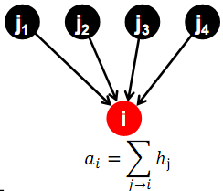
HITS: Algorithm
Κεφ. 21.3
Each page p, has two scores
  A hub score (h) quality as an expert
  Total sum of authority scores that it points to
  An authority score (a) quality as content
Total sum of hub scores that point to it

Slide 60
HITS: Algorithm
Κεφ. 21.3
Authority Update Rule: For each page i, update a(i) to be the sum of the hub scores of all pages that point to it.
Hub Update Rule: For each page i, update h(i) to be the sum of the authority scores of all pages that it points to.

Slide 61
HITS: Algorithm
Κεφ. 21.3
Start with all hub scores and all authority scores equal to 1.
Perform a sequence of k hub-authority updates. For each node:
- First, apply the Authority Update Rule to the current set of scores.
- Then, apply the Hub Update Rule to the resulting set of scores.
At the end, hub and authority scores may be very large.
Normalize: divide each authority score by the sum of all authority scores, and each hub score by the sum of all hub scores.

Slide 62
High-level scheme
Κεφ. 21.3
Extract from the web a base set of pages that could be good hubs or authorities.
From these, identify a small set of top hub and authority pages;
  iterative algorithm.

Slide 63
Base set
Κεφ. 21.3
Given text query (say browser), use a text index to get all pages containing browser.
  Call this the root set of pages.
Add in any page that either
  points to a page in the root set, or
  is pointed to by a page in the root set.
Call this the base set.

Slide 64
Visualization
Κεφ. 21.3
Root
set
Base set

Slide 65
Distilling hubs and authorities
Κεφ. 21.3
Compute, for each page x in the base set, a hub score h(x) and an authority score a(x).
Initialize: for all x, h(x)←1; a(x) ←1;
Iteratively update all h(x), a(x);
After iterations
  output pages with highest h() scores as top hubs
  highest a() scores as top authorities.
Key

Slide 66
Iterative update
Κεφ. 21.3
Repeat the following updates, for all x:
x
x

Slide 67
Scaling
Κεφ. 21.3
To prevent the h() and a() values from getting too big, can scale down after each iteration.
Scaling factor doesn’t really matter:
  we only care about the relative values of the scores.

Slide 68
How many iterations?
Κεφ. 21.3
Claim: relative values of scores will converge after a few iterations:
  in fact, suitably scaled, h() and a() scores settle into a steady state!
In practice, ~5 iterations get you close to stability.

Slide 69
Japan Elementary Schools
Κεφ. 21.3
Hubs
Authorities
schools
LINK Page-13
“ú–{‚ÌŠwZ
a‰„¬ŠwZƒz[ƒƒy[ƒW
100 Schools Home Pages (English)
K-12 from Japan 10/...rnet and Education )
http://www...iglobe.ne.jp/~IKESAN
‚l‚f‚j¬ŠwZ‚U”N‚P‘g•¨Œê
ÒŠ—’¬—§ÒŠ—“Œ¬ŠwZ
Koulutus ja oppilaitokset
TOYODA HOMEPAGE
Education
Cay's Homepage(Japanese)
–y“ì¬ŠwZ‚Ìƒz[ƒƒy[ƒW
UNIVERSITY
‰J—³¬ŠwZ DRAGON97-TOP
Â‰ª¬ŠwZ‚T”N‚P‘gƒz[ƒƒy[ƒW
¶µ°é¼ÂÁ© ¥á¥Ë¥å¡¼ ¥á¥Ë¥å¡¼
The American School in Japan
The Link Page
‰ªès—§ˆä“c¬ŠwZƒz[ƒƒy[ƒW
Kids' Space
ˆÀés—§ˆÀé¼•”¬ŠwZ
‹{é‹³ˆç‘åŠw•‘®¬ŠwZ
KEIMEI GAKUEN Home Page ( Japanese )
Shiranuma Home Page
fuzoku-es.fukui-u.ac.jp
welcome to Miasa E&J school
_“ÞìŒ§E‰¡•ls—§’†ì¼¬ŠwZ‚Ìƒy
http://www...p/~m_maru/index.html
fukui haruyama-es HomePage
Torisu primary school
goo
Yakumo Elementary,Hokkaido,Japan
FUZOKU Home Page
Kamishibun Elementary School...

Slide 70
Things to note
Κεφ. 21.3
Pulled together good pages regardless of language of page content.
Use only link analysis after base set assembled
  iterative scoring is query-independent.
Iterative computation after text index retrieval - significant overhead.

Slide 71
Issues
Κεφ. 21.3
Topic Drift
  Off-topic pages can cause off-topic “authorities” to be returned
    E.g., the neighborhood graph can be about a “super topic”
Mutually Reinforcing Affiliates
  Affiliated pages/sites can boost each others’ scores
    Linkage between affiliated pages is not a useful signal

Slide 72
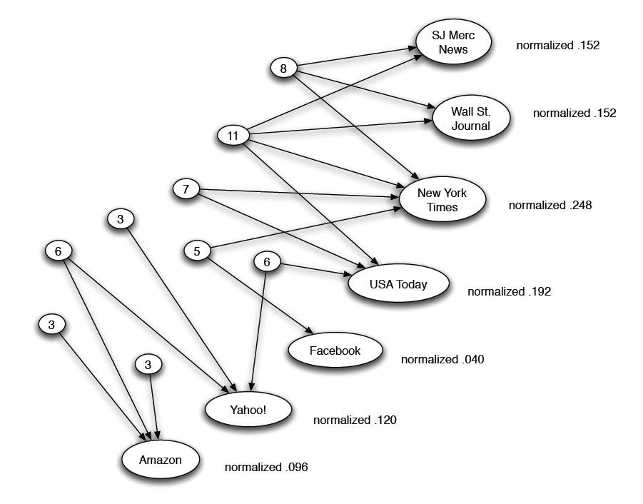
HITS: Algorithm
Κεφ. 21.3

Slide 73
HITS: Διανυσματική Αναπαράσταση
Κεφ. 21.3
Adjacency matrix
Aij = 1 if i->j
0, otherwise
Two vectors
a: with authority ranks
h: with hup ranks

Slide 74
Rewrite in matrix form
Κεφ. 21.3
h=Aa.
a=A^{t}h.
Recall A^{t} is the transpose of A.
Substituting, h=AA^{t}h and a=A^{t}Aa.
Thus, h is an eigenvector of AA^{t} and a is an eigenvector of A^{t}A.
Further, our algorithm is a particular, known algorithm for computing eigenvectors: the power iteration method.
Guaranteed to converge.

Slide 75
Proof of convergence
Κεφ. 21.3
n×n adjacency matrix A:
  each of the n pages in the base set has a row and column in the matrix.
  Entry A_{ij} = 1 if page i links to page j, else = 0.
1 2 3
1
2
1
2
3
0 1 0
1 1 1
3
1 0 0

Slide 76
Hub/authority vectors
Κεφ. 21.3
View the hub scores h() and the authority scores a() as vectors with n components.
Recall the iterative updates

Slide 77
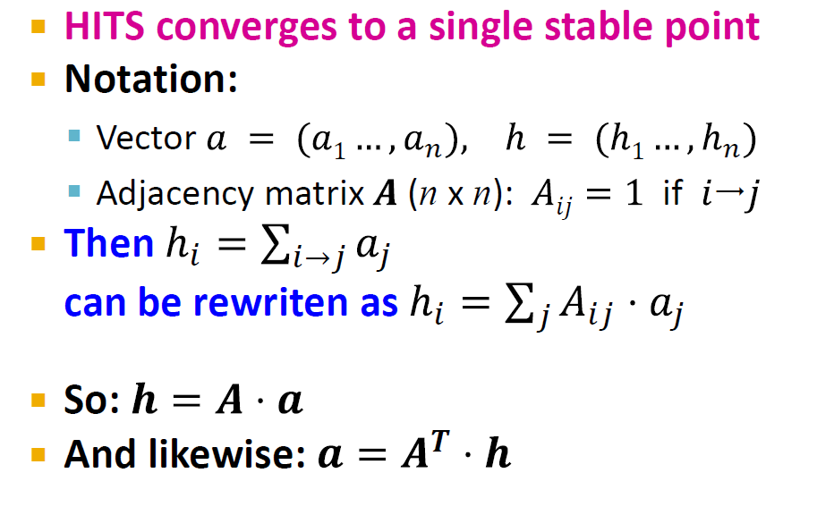
HITS: Διανυσματική Αναπαράσταση
Κεφ. 21.3

Slide 78
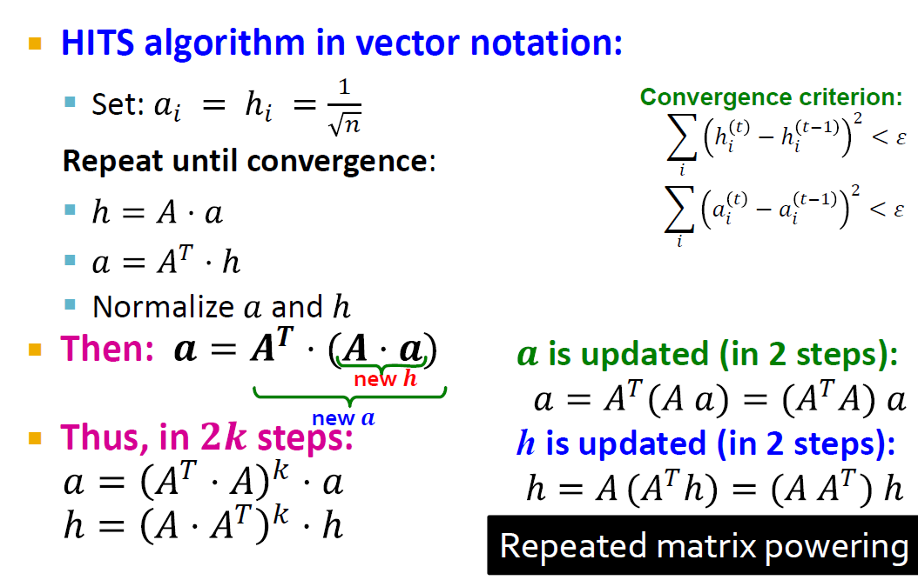
HITS: Διανυσματική Αναπαράσταση
Κεφ. 21.3

Slide 79
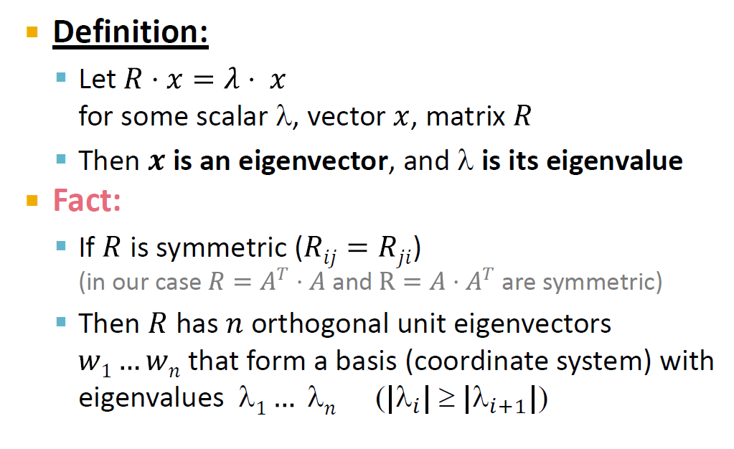
HITS: Spectral Analysis
Κεφ. 21.3

Slide 80
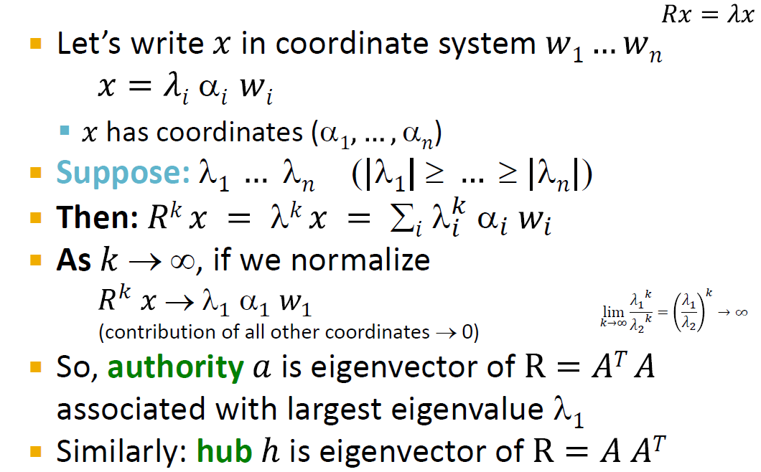
HITS: Spectral Analysis
Κεφ. 21.3

Slide 81
HITS: Spectral Analysis
Κεφ. 21.3

Slide 82
PageRank vs HITS
Κεφ. 21.3
PageRank can be precomputed, HITS has to be computed at query time.
  HITS is too expensive in most application scenarios.
PageRank and HITS make two different design choices concerning (i) the eigenproblem formalization (ii) the set of pages to apply the formalization to.
These two are orthogonal.
  We could also apply HITS to the entire web and PageRank to a small base set.
Claim: On the web, a good hub almost always is also a good authority.
The actual difference between PageRank ranking and HITS ranking is therefore not as large as one might expect.

Slide 83
Περίληψη
Κεφ. 21.3
Anchor text: What exactly are links on the web and why are they important for IR?
PageRank: the original algorithm that was used for link-based ranking on the web
Hubs & Authorities: an alternative link-based ranking algorithm
  Google’s official description of PageRank: PageRank reflects our view of the importance of web pages by considering more than 500 million variables and 2 billion terms. Pages that believe are important pages receive a higher PageRank and are more likely to appear at the top of the search results.

Slide 84
ΤΕΛΟΣ 10^{ου} Μαθήματος
Ερωτήσεις?
Χρησιμοποιήθηκε κάποιο υλικό από:
Pandu Nayak and Prabhakar Raghavan, CS276:Information Retrieval and Web Search (Stanford)
Hinrich Schütze and Christina Lioma, Stuttgart IIR class

