Slide 1
Fast StartUpNow Bootcamp
Demetris Gerogiannis, Ph.D.

Slide 2
I have an idea!

Slide 3
The reality…
Pivot!

Slide 4
I. The Business Model Canvas

Slide 5
Let’s make things simple…
€ OUT
€ IN

Slide 6

Revenue Streams
  Subscriptions (Flat)
  Commission (%)
  License Fee (Flat)
  Per Unit/Item
  Combination
Usually for Services
Usually for patents
Usually for physical/digital goods

Slide 7

Cost Structure
  Initial Costs (CAPEX)
  Operational Costs (OPEX)
  Human Resources
  Unit Costs
    SMS/Email/Push Notifications…
    Plastic Membership Card
    Marketing (Ads…)
Fixed Costs

Slide 8

How much do we sell?
Profit
OUT
IN

Slide 9
II. The Value Proposition Canvas

Slide 10
Validation of business idea…
The owl mother believes her babies are the prettiest! (Aesop’s Myth)

Slide 11
Why is the Value Proposition Important?
72% of products fail to deliver value*
The viability of a company relies on how strong the Value Proposition is!
* Source: Simon-Kucher & Partners, 2014

Slide 12
Deus Ex machina…

Slide 13
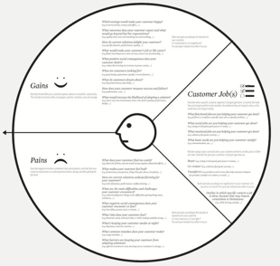
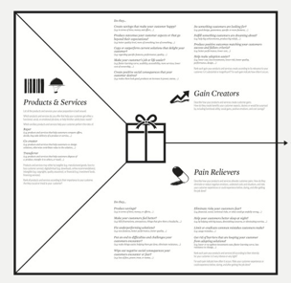
The Value Proposition Canvas
The Client (Customer Profile – Persona)
  Activities/Tasks
  Pains
  Gains
The Value Proposition (Value map)
  The Product/Service
  Pain Relievers
  Gain Creators

Slide 14
Example of a VPC
Business Idea: Coffee Delivery to Students
Student:
  Task: Drink Coffee in the morning
  Pain: Need to get up, dress up, go to the closest coffee shop
  Gain: Actually wake up!!!
The Value Proposition:
  Service: Mobile App
  Pain Reliver: No need to move from my bed
  Gain Creator: I have my coffee delivered!

Slide 15
Concluding…
BMC
Financial Projections
Pitch Deck
Development (MVP)
VPC
MVP / Iterations

Slide 16
Navigation tips…
business
Iidea
Fast! Fast! Fast!

Slide 17
Thank You!
Demetris Gerogiannis
dgerog
demetris@finabyss.com

