Slide 1
Online Social Networks and Media
Polarization
Fairness

Slide 2
Polarization
Slides taken from EUROCSS 2019 Tutorial: Polarization on Social Media
Kiran Garimella, Gianmarco De Francisci Morales, Michael Mathioudakis, Aristides Gionis

Slide 3
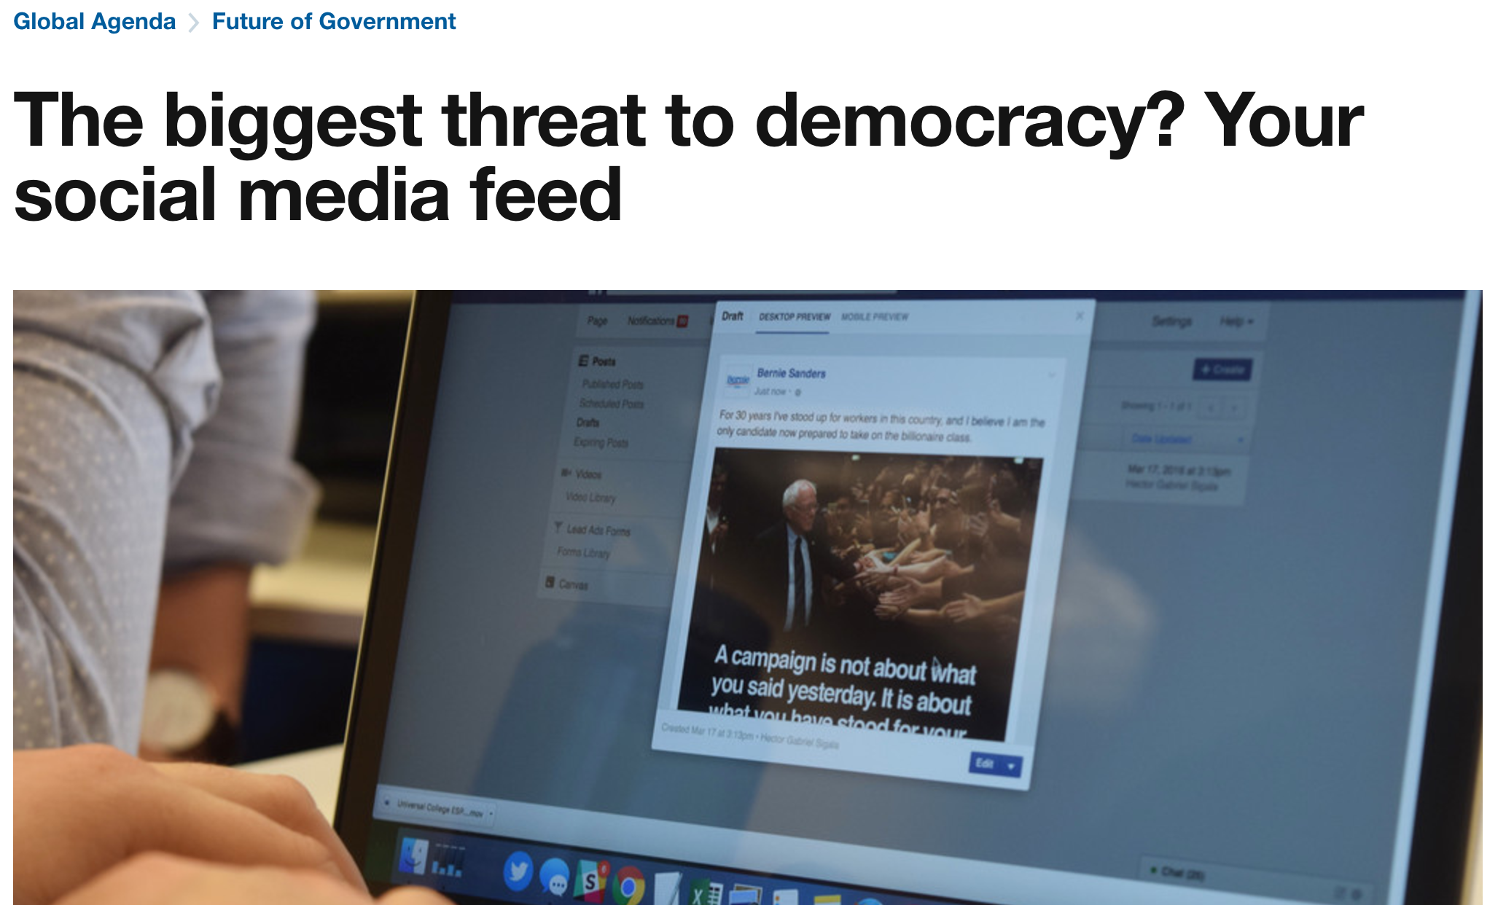
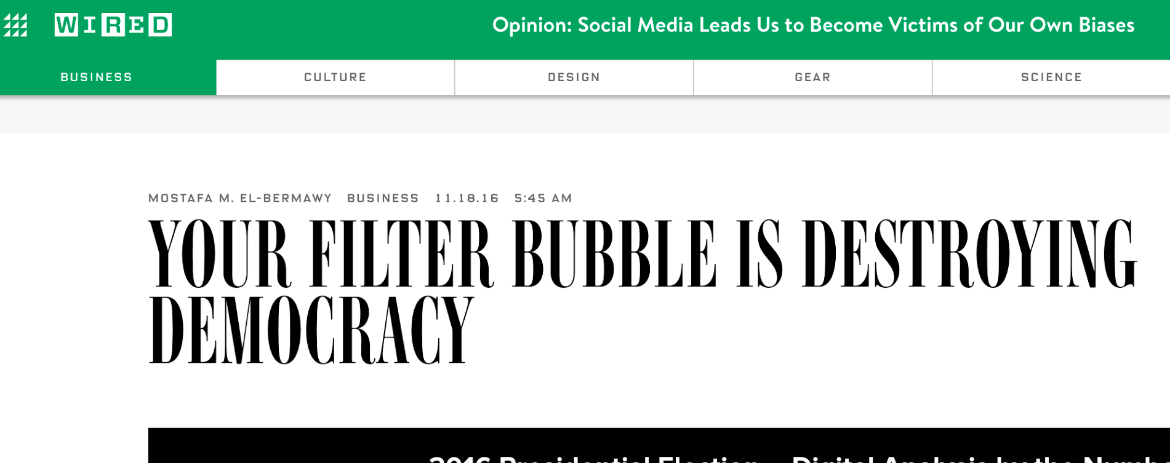
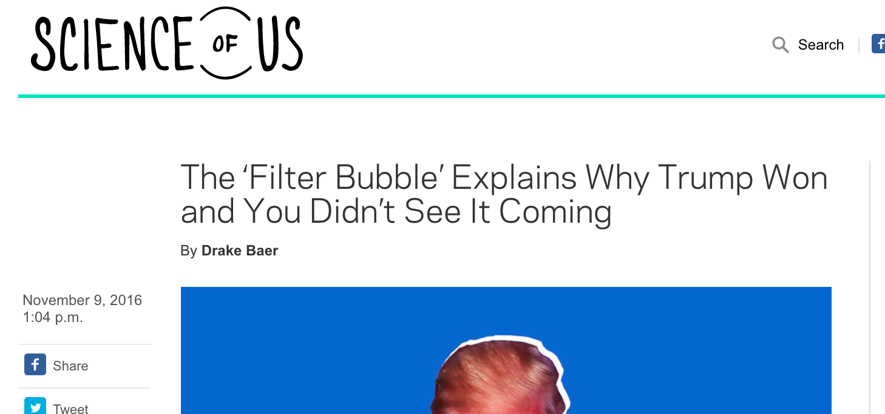
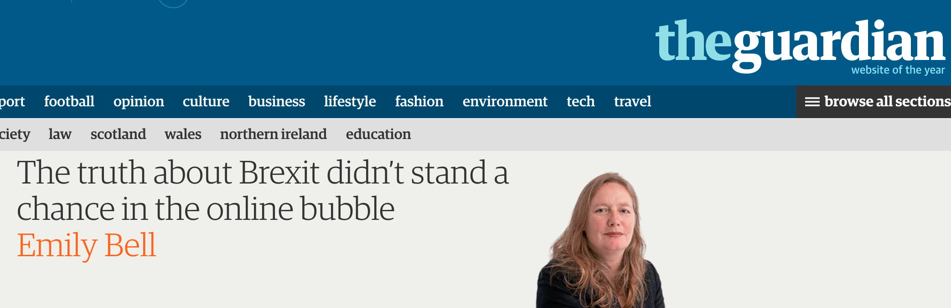
Polarization in Social Networks
There is a growing concern that social media make the public more polarized and extreme
polarization
online bubble
more polarization
Notes:
Should we define what these bubbles are? What are social media bubbles?

Slide 4
What is polarization?
The term is used in various domains with similar meaning
Political polarization (Wikipedia) “the divergence of political attitudes to ideological extremes.”
https://en.wikipedia.org/wiki/Polarization_(politics)
Social polarization “the segregation within a society that may emerge from income inequality, real-estate fluctuations, economic displacements, etc.”
https://en.wikipedia.org/wiki/Social_polarization
Oxford Dictionary “Division into two sharply contrasting groups or sets of opinions or beliefs.”
Ref: https://en.oxforddictionaries.com/definition/polarization
Notes:
Used interchangably with ‘controversy’...
Oxford Dictionary: https://en.oxforddictionaries.com/definition/polarization

Slide 5
Why is it important to study?
How we handle disagreement is essential to democratic process
  A large part of the discussion has moved to social media
Because polarization might be linked to adverse effects
  Social segmentation and stereotypes
  Echo chambers
    Decrease in deliberation
    Hinders deliberative democracy
Need to be aware of our biases
  Sometimes we might not hear opposing views
  Biases around us (e.g., algorithmic personalization)
However, not necessarily negative in itself
Notes:
MM: the bit about dictatorships is not clear to me

Slide 6
Psychological mechanisms of polarization
Mechanisms that manifest when humans are confronted with information that challenges their beliefs
Polarization involves…
  … arguments and counter-arguments
  … evidence that is conflicting or interpreted differently
  … different points of view – that might challenge our own
How do we react to opposing opinions / arguments / evidence that challenge their opinion?
  Do we update our beliefs? How?
  Are we influenced by the beliefs of others?
  Do we use evidence to update our beliefs?
  Or use our beliefs to judge evidence?
Psychologists & cognitive scientists have studied these questions for long

Slide 7
Cognitive dissonance
People experience discomfort when presented with information that challenges their beliefs or decisions
Fischer et al. “The theory of cognitive dissonance: State of the science and directions for future research.” 2008.
Extensively studied behavior, theory first formulated in the 1950’s
Festinger. “A Theory of Cognitive Dissonance.” 1957.
Notes:
https://en.wikipedia.org/wiki/Cognitive_dissonance
https://en.wikipedia.org/wiki/Closure_(psychology)

Slide 8
Cognitive dissonance
’Cognition’: broadly defined
  Element of knowledge, belief, value
’Dissonance’ – i.e., ’lack of harmony or agreement’
  Subjective perception of incompatibility / discrepancy between cognitions
  Psychological discomfort
  Motivation to reduce discomfort
Reduce discomfort by…
  Adding or highlighting consonant cognitions
  Removing or downplaying dissonant cognitions

Slide 9
Examples of Cognitive Dissonance
Selective exposure
Klapper. “The effects of mass communication.” 1960
  Subjects choose to examine items that agree with their decision
Biased assimilation
Lord et al. “Biased assimilation and attitude polarization: The effects of prior theories on subsequently considered evidence.” 1979
  Subjects find consonant evidence more convincing
Free-choice
Brehm. “Postdecision changes in the desirability of alternatives.” 1956
  Spreading-apart-of-alternatives
Induced compliance
Festinger and Carlsmith. “Cognitive consequences of forced compliance.” 1959
  Subjects justify their decisions a-posteriori, even if they originally disagreed
Notes:
Citation for Biased Assimilation: Lord, C.G., Ross, L. and Lepper, M.R., 1979. Biased assimilation and attitude polarization: The effects of prior theories on subsequently considered evidence. Journal of personality and social psychology.

Slide 10
Cognitive Bias
Cognitive dissonance may lead to cognitive bias:
  a systematic thought process caused by the tendency of the human brain to simplify information processing through a filter of personal experience and preferences. The filtering process is a coping mechanism that enables the brain to prioritize and process large amounts of information quickly.
  https://www.techtarget.com/searchenterpriseai/definition/cognitive-bias
  a systematic pattern of deviation from norm or rationality in judgment.
  https://en.wikipedia.org/wiki/Cognitive_bias
Examples of Cognitive Bias:
  Confirmation bias
  Priming
  Framing
  Anchoring

Slide 11
Group biases
Earlier discussion: bias mechanisms at individual level
Biases can also manifest at group level
Social identity complexity
  Individuals associate themselves with social identities
  race, religion, gender, class
Roccas, S. and Brewer, M.B., 2002. Social identity complexity. Personality and Social Psychology Review.
Group polarization
  The tendency for a group to make decisions that are more extreme than the initial inclination of its members
  Sunstein, C.R., 2002. The law of group polarization. Journal of political philosophy.
Notes:
https://en.wikipedia.org/wiki/Group_polarization
https://en.wikipedia.org/wiki/Groupthink
https://en.wikipedia.org/wiki/Communal_reinforcement

Slide 12
Summary
Cognitive dissonance prompts people to expose themselves to confirming information
  What is consonant or dissonant might also depend on group participation
What could go wrong?
People share their views on the same platforms they use to consume information
  Eg: Facebook, Twitter
If platforms are aware of user views and aim to maximize user satisfaction, what content will they show to users?
  Why show dissonant content?

Slide 13
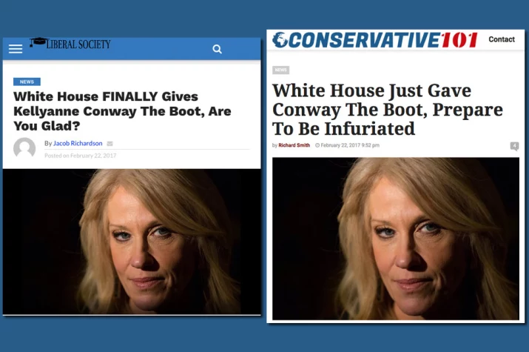
Media bias
Media present information differently based on their audience
Notes:
Interesting case study https://www.buzzfeed.com/craigsilverman/how-the-hyperpartisan-sausage-is-made?utm_term=.fwY6MxBdq#.jxYWeq2K8

Slide 14

Algorithmic bias
Online content platforms present information to match individual users
Algorithmic personalization
  News
  Search engines
  Social media
Filter bubble
  We do not see the same content

Slide 15
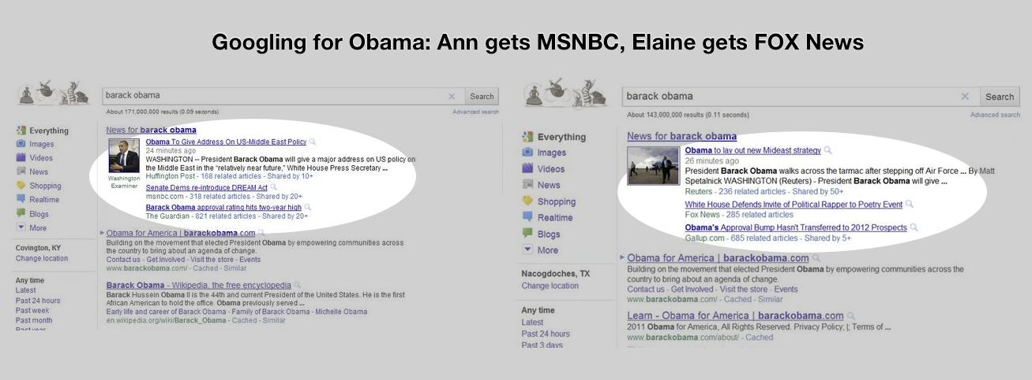
Filter bubble
Notes:
http://1.bp.blogspot.com/-LesG0r1cuWo/TfXqFBIRSJI/AAAAAAAAAXk/t_i8TmSSXEQ/s1600/ComparisonObama.png
https://hoesociaal.files.wordpress.com/2011/12/comparisonclimate.png

Slide 16
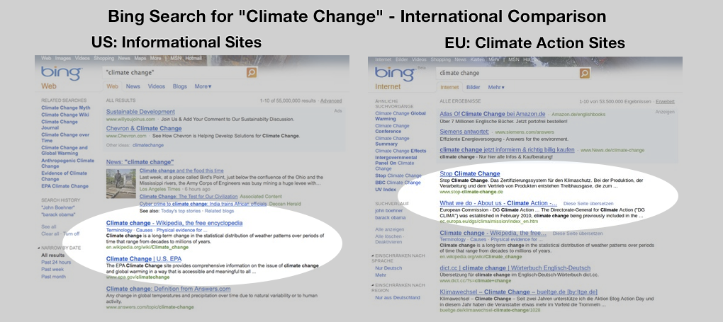
Filter bubble
Notes:
http://1.bp.blogspot.com/-LesG0r1cuWo/TfXqFBIRSJI/AAAAAAAAAXk/t_i8TmSSXEQ/s1600/ComparisonObama.png
https://hoesociaal.files.wordpress.com/2011/12/comparisonclimate.png

Slide 17
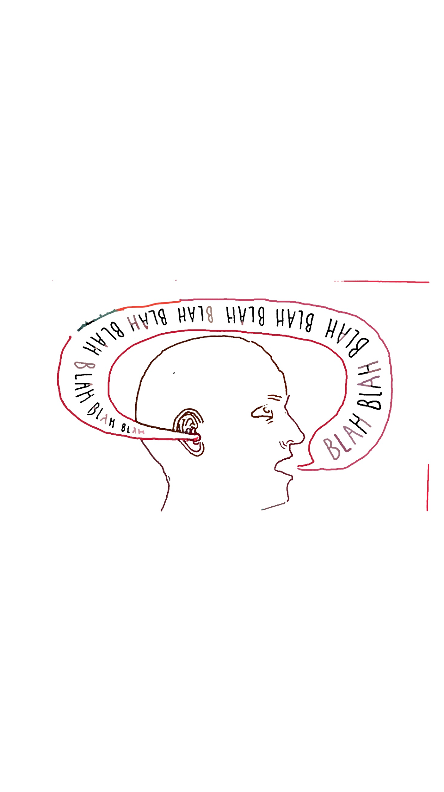
Why the Web might increase polarization
Increase in available information
Increase in filtering power
  People tend to avoid reading conflicting information
Increase in social feedback (with social media)
  Homogeneity and group-think reinforced
Echo chambers
‘Tribal enclaves’ in which people hear and reinforce their own opinions

Slide 18
Polarization
Catalysts
Media bias
Algorithmic bias
Group polarization
Echo chambers
Filter bubbles
Information overload
Leads to
Homophily
Selective exposure
Biased
assimilation
Social identity complexity
Causes
Cognitive Dissonance
Notes:
All these have existed before, except algorithmic bias.

Slide 19
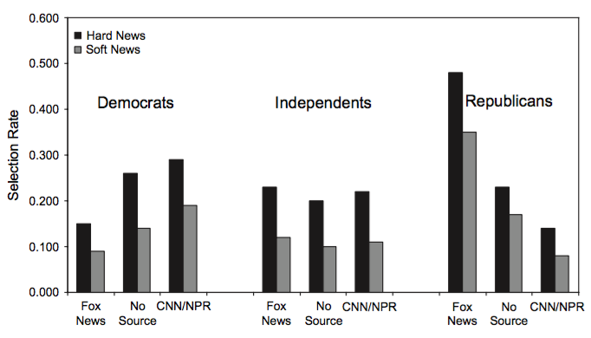
Ideological Selectivity in News
Iyengar, S., & Hahn, K. S. "Red media, blue media: Evidence of ideological selectivity in media use." (2009)
People prefer to read news from sources close to their leaning
Finding consistent with selective exposure
Online user study with randomized experiments in US
Headlines for 4 articles, labeled randomly as coming from 4 different sources:
  Fox News, CNN, NPR, BBC
  Control group sees same stories with no media logo
380 stories, 1020 users
Tendency to select news based on
anticipated agreement as predicted
by cognitive dissonance theory
Effect stronger for hard news

Slide 20
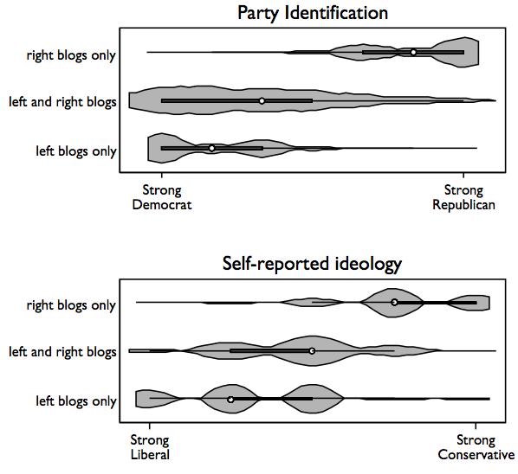
Echo Chambers in Blog Readership
Lawrence, E., Sides, J., & Farrell, H. “Self-segregation or deliberation? Blog readership, participation, and polarization in American politics.” (2010)
Data from large survey (N=36,000)
Blog readers are attracted to blogs aligned with their political views (94%)
Polarization both by party identification and
self-reported ideology
Finding consistent with selective exposure
Notes:
Violin plots
Shaded area represent the density. Inside the shaded area are a single dot, representing the
median; a dark box, capturing the interquartile range; and a thin line extending from the lower
adjacent value to the upper adjacent value

Slide 21
Echo Chambers on Twitter
Garimella et.al., “Political Discourse on Social Media: Echo Chambers, Gatekeepers, and the Price of Bipartisanship.” WWW2018.
Fixed set of politically active users
Set of tweets that mention #topic
Production vs consumption score
Main finding: correlation of production and consumption scores
Finding consistent with selective exposure

Slide 22
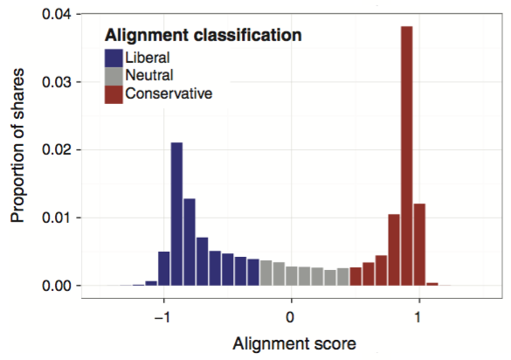
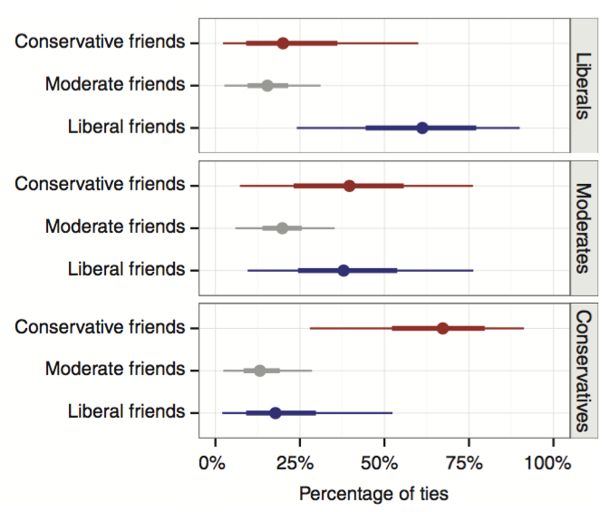
Partisan Exposure on Facebook
Bakshy, E., Messing, S., & Adamic, L. A. "Exposure to ideologically diverse news and opinion on Facebook." (2015)
US Facebook users with self-reported ideological affiliation
Analysis on hard news (national news, politics, world affairs)
Each news associated with a political alignment
  Average of the affiliation of users who shared the story
Cross-cutting news if the alignment of the news and the user differ

Slide 23
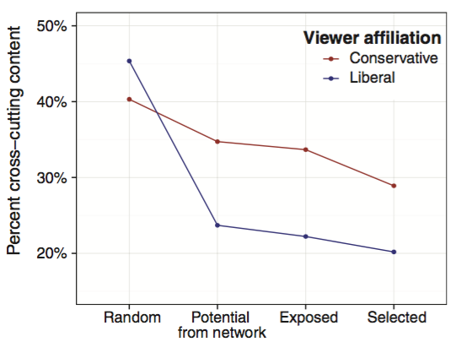
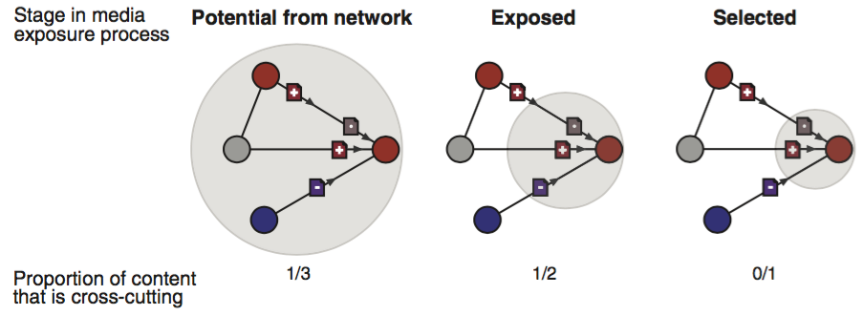
Partisan Exposure
Bakshy, E., Messing, S., & Adamic, L. A. "Exposure to ideologically diverse news and opinion on Facebook." (2015)
Measure the fraction of
cross-cutting news among:
  ones posted in a user’s network (potential)
  ones shown in the user’s timeline (exposed)
  one the user clicked on (selected)
Compared to random from the whole set, each step reduces the exposure and creates a narrower echo chamber
Largest reduction from network (social), rather than algorithmic (filtering), selective exposure still plays a role
Notes:
Group > algorithm > personal?

Slide 24
Why the Web might not increase polarization
Homophily is not observed only for one type of issues (political)
  The tendency of individuals to associate and bond with similar others
  Could be based on various facets
    Gender, age, race, status, religion, geography, beliefs
Reality kicks in
  Evidence accumulates at some point
Notes:
Shall we move 38—40 to part 5??

Slide 25
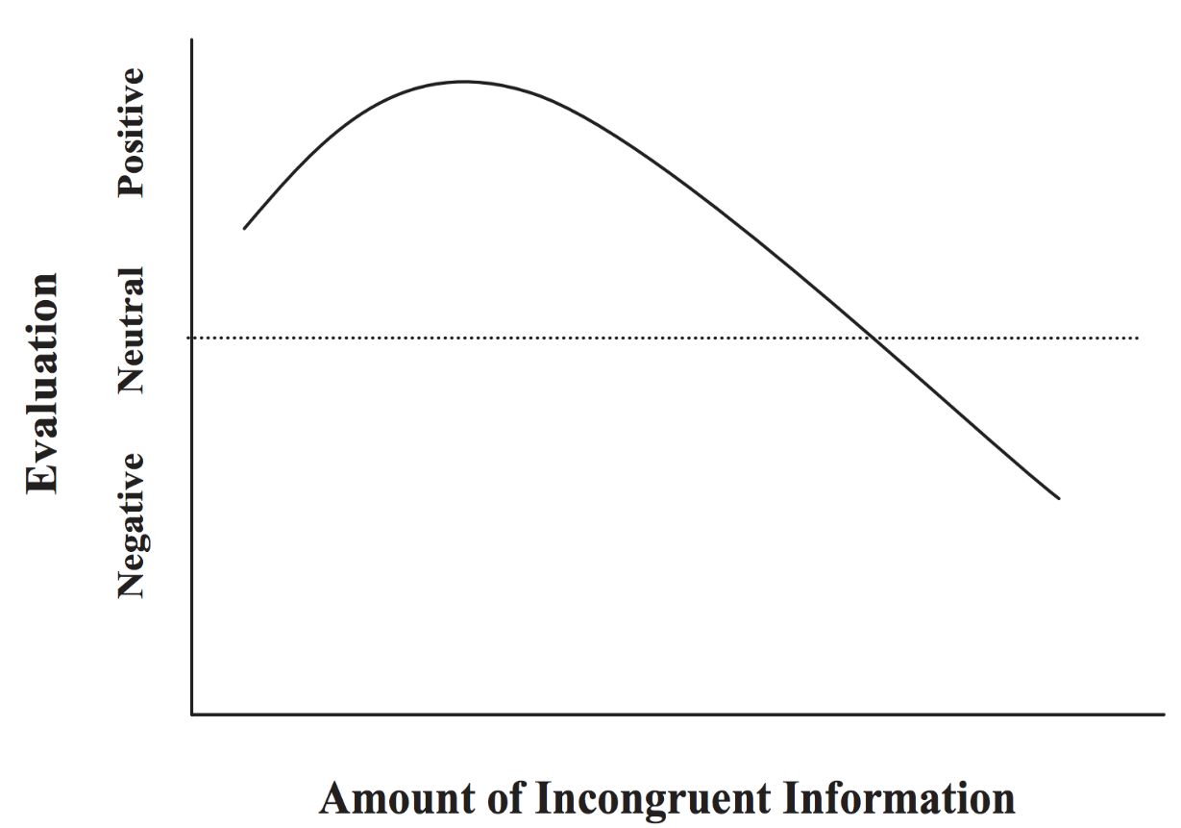
Is there a tipping point?
Redlawsk D, The Affective Tipping Point: Do Motivated Reasoners Ever “Get It”? (2010)
Backfire effect
Notes:
https://youarenotsosmart.com/2017/02/11/yanss-095-how-to-fight-back-against-the-backfire-effect/

Slide 26
Backfire effect
Recent study (Bail et al, 2018)
Surveyed a large sample (N=1652) of politically active twitter users, Democrats and Republicans
Paid them to follow a Twitter bot for one month that exposed them to content of opposing political ideologies.
Resurveyed after 1 month
Finding:
  Republicans who followed a liberal Twitter bot became substantially more conservative post-treatment
  Democrats who followed a conservative Twitter bot became slightly more liberal post-treatment
Bail, et al “Exposure to Opposing Views can Increase Political Polarization: Evidence from a Large-Scale Field Experiment on Social Media.” (2018)

Slide 27
MeasurING Polarization

Slide 28
Polarization in content
Sentiment variance in news
Controversial topic - a concept that invokes conflicting sentiments
Subtopic - factor that gives a particular sentiment (+ve or -ve)
Assumption - a controversial topic receives contrasting sentiment (of different kind)
  positive vs. negative feelings, pros vs. cons, rightness vs. wrongness in their judgments
Similar results observed by
  Garimella et al. WSDM 2016
  Klenner et al. KONVENS 2014
Choi, Jung , and Myaeng. “Identifying controversial issues and their sub-topics in news articles.” PAW-ISI 2010.
Garimella, De Francisci Morales, Gionis, and Mathioudakis. “Quantifying Controversy in Social Media.” WSDM 2016.
Klenner, Amsler, Hollenstein, and Faaß. “Verb Polarity Frames: a New Resource and its Application in Target-specific Polarity Classification.” KONVENS 2014.
Notes:
Identifying controversial issues and their sub-topics in news articles.
https://link.springer.com/chapter/10.1007/978-3-642-13601-6_16

Slide 29
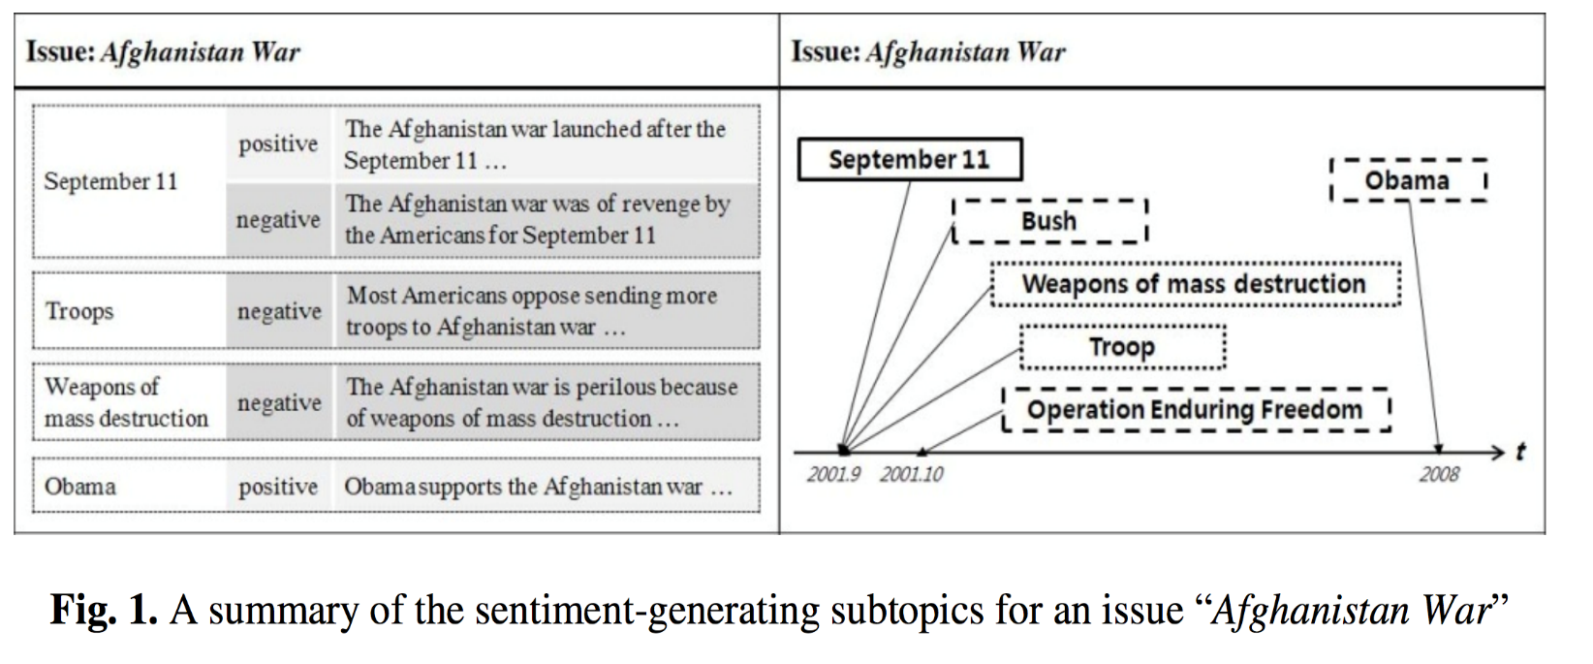
Sentiment variance
Method:
  Identify candidate entities (noun phrases)
  Compute sentiment in sentences involving these entities
  Controversial if positive_sentiment + negative_sentiment > δ
  and |positive - negative| > ϒ
Notes:
Verb Polarity Frames: a New Resource and its Application in Target-specific Polarity Classification
https://hildok.bsz-bw.de/files/251/p038.pdf

Slide 30
Controversy language in news
Controversy lexicon
Controversial topics have:
  strongly biased terms
  more negative terms
  fewer strongly emotional terms
“we show that we can indicate to what extent an issue is controversial, by comparing it with other issues in terms of how they are portrayed across different media.”
Mejova, Zhang, Diakopoulos, and Castillo. “Controversy and Sentiment in Online News.” C+J Symposium 2014.
Notes:
Bias detected from wikipedia, sentiment from sentiment lexicon, controversial words crowdsourced

Slide 31
Detecting controversy on the Web
Find out if a Web page discusses a (known) controversial topic
Map topics (named entities) in a Web page to Wikipedia articles
  A Web page is controversial if it is similar to a controversial Wikipedia article
  E.g., If a news article mentions Abortion it is controversial
Related:
  There is a lot of work on identifying controversial topics on Wikipedia
  Edit wars, hyperlink structure, etc.
Related:
  Jang et al. show that in addition to this, language models can be built to directly detect controversy
Dori-Hacohen and Allan. “Detecting Controversy on the Web.” CIKM 2013.
Jang, Foley, and Allan. “Probabilistic Approaches to Controversy Detection.” CIKM 2016.
Notes:
Mention that there’s a ton of work in identifying controversial topics on wikipedia, using edit wars
Comparative study: Rad, Hoda Sepehri, and Denilson Barbosa “Identifying controversial articles in Wikipedia: A comparative study,” WikiSym ‘12

Slide 32
Identifying polarization - Network
Methods based on network structure
  Social media, hyperlinks
  Twitter: Retweet,ReplymSocial (follow)
Idea: Controversial topics have a clustered structure in their discussions

Slide 33
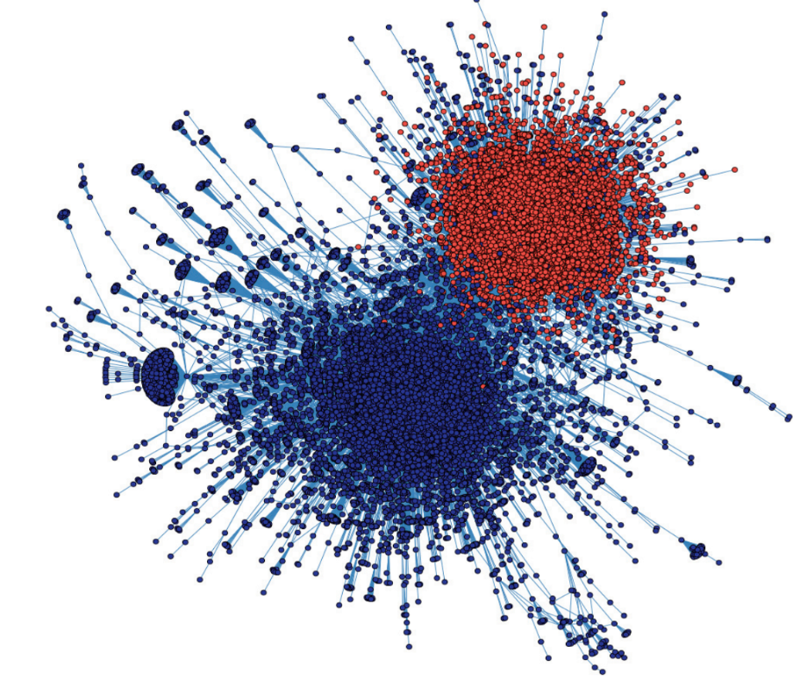
Quantifying polarization via Modularity
Modularity:
  the fraction of the edges that fall within the given groups minus the expected fraction if edges were distributed at random
  Compares the number of edges inside a cluster with the expected on a random graph
  Captures the strength of division of a network into modules
Modularity: 0.48
Conover, Ratkiewicz, Francisco, Gonçalves, Menczer, and Flammini. “Political Polarization on Twitter.” ICWSM 2011.
Notes:
https://en.wikipedia.org/wiki/Modularity_(networks)

Slide 34
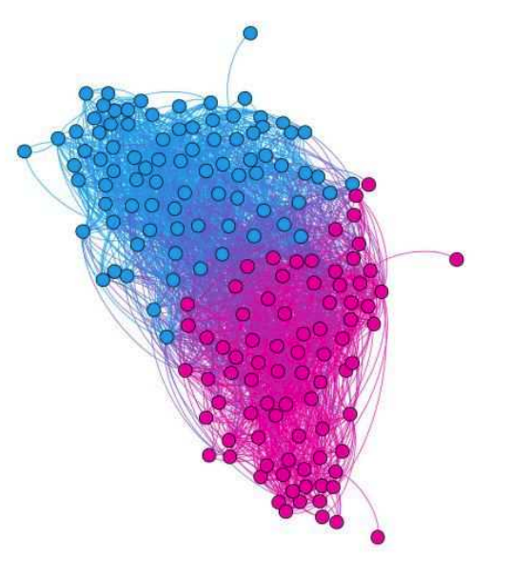
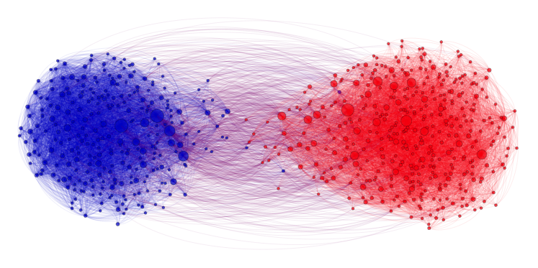
Modularity is not a direct measure of polarization
We want to capture the in group vs out group interaction preference
Sensitive to the size of the graph and partitions
Not “monotone”
  Strengthening of internal ties can decrease modularity
How much modularity indicates polarization?
Modularity: 0.42
Modularity: 0.24
Notes:
What is the threshold for modularity?

Slide 35
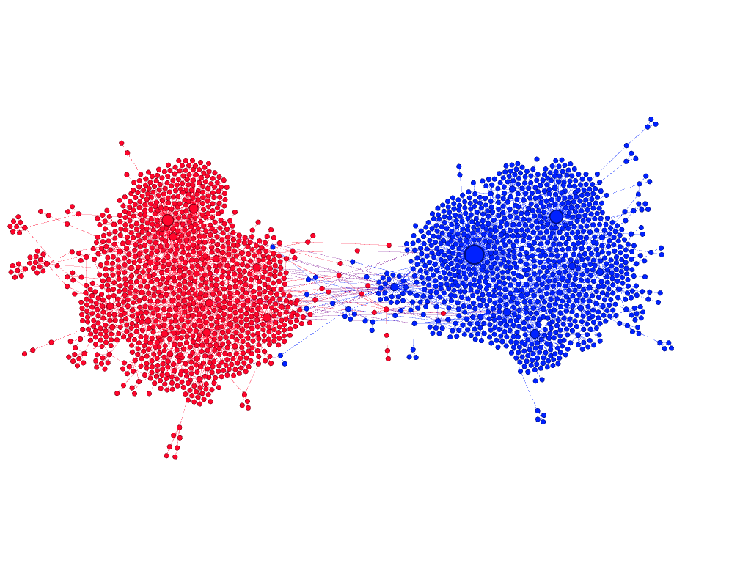
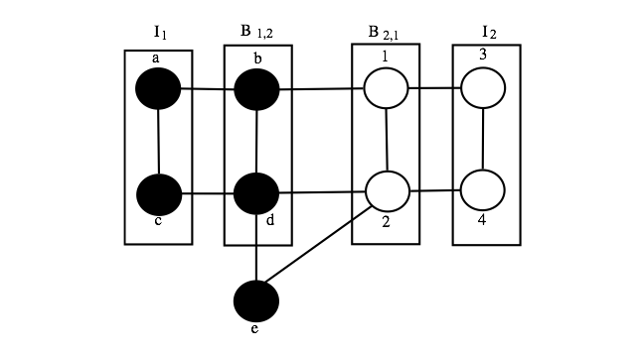
Community boundary
Guerra, Meira, Cardie, and Kleinberg. “A Measure of Polarization on Social Media Networks Based on Community Boundaries.”
ICWSM 2013.
Boundary node:
  have at least one edge that connecting to the other community
  have at least one edge connecting to a member of its community which does not link to the other community
P(v) = d_{internal}(v)/(d_{external}(v) + d_{internal}(v)) – 0.5
P(v) > 0 → v prefers internal connections (antagonism?)
P(v) < 0 → v prefers connections with members of the other group
Notes:
b connects equally to the back community (a) and to the white community (1), so it’s not polarized. Boundary-boundary links are not considered.

Slide 36
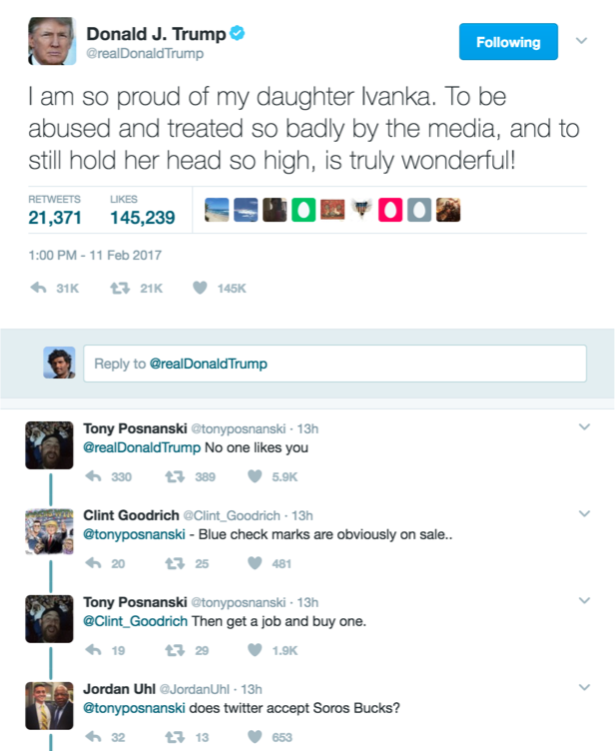
Motif-based approach
Coletto, Garimella, Luchesse, and Gionis. “A Motif-based Approach for Identifying Controversy.” OSNEM. 2017.
Define reply trees
Identify frequency of motifs in these trees
Take into account also social graph
  follower information

Slide 37
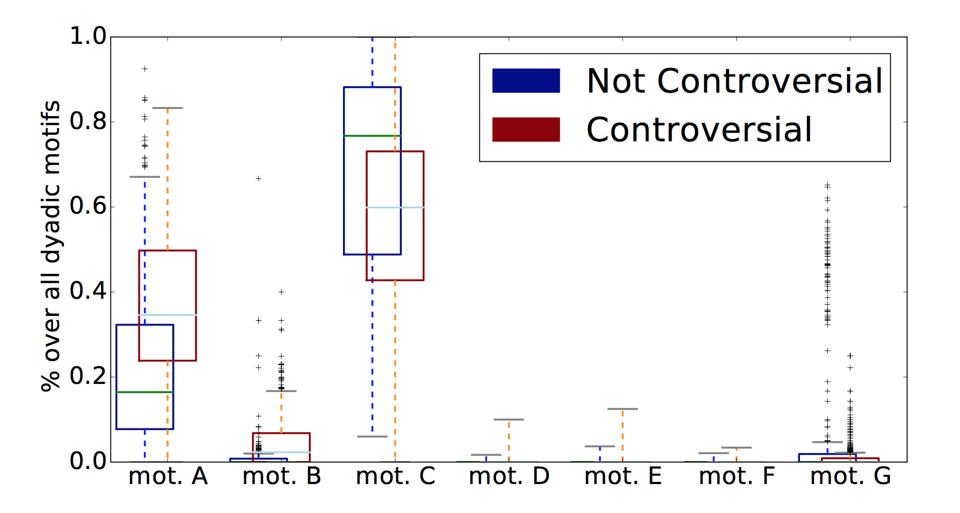
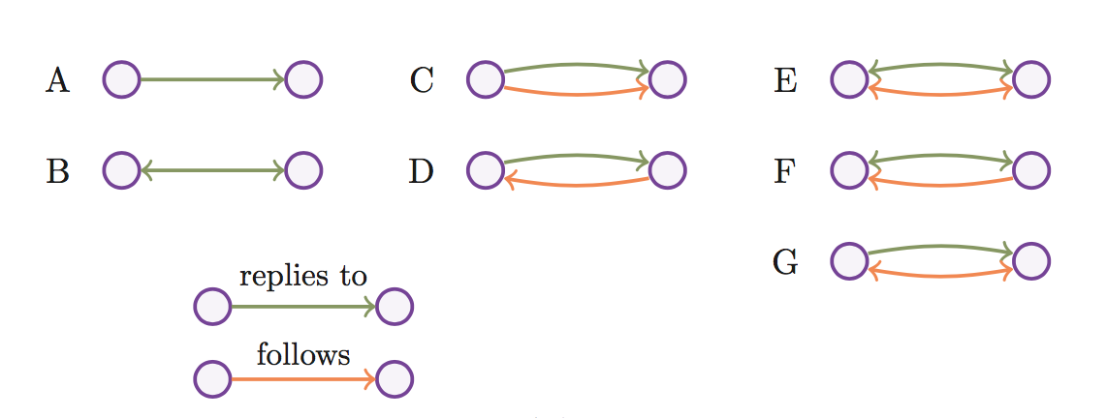
Motifs

Slide 38
Based on information flow
Garimella, De Francisci Morales, Gionis, and Mathioudakis. “Quantifying Controversy in Social Media.” WSDM 2016.
Random walk controversy measure (RWC)
  Authoritative users exist on both sides of the controversy
  How likely a random user on either side is to be exposed to authoritative content from the opposing side
Works on both the retweet graph and the social graph
Requires a partition of the graph
Notes:
Recive accept sample model (RAS) https://en.wikipedia.org/wiki/The_Nature_and_Origins_of_Mass_Opinion

Slide 39
Random walk controversy score
X
Y

Slide 40
Random walk controversy score
X
Y

Slide 41
Random walk controversy score
X
Y

Slide 42
Random walk controversy score (RWC)

Slide 43
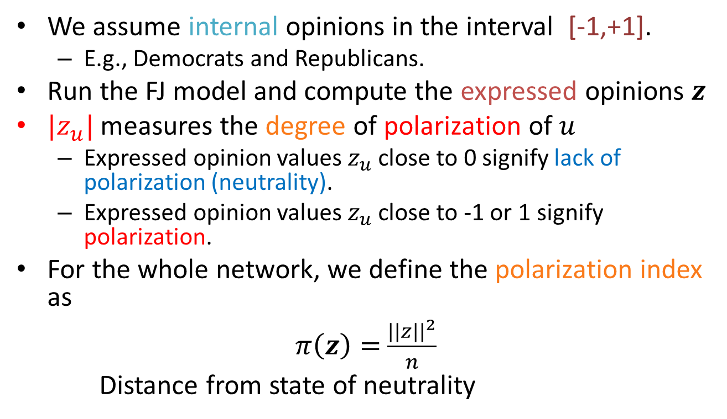
Polarization via Opinion Formation model
We assume internal opinions in the interval [-1,+1].
  E.g., Democrats and Republicans.
Run the FJ model and compute the expressed opinions $z$
$|z_{u}|$ measures the degree of polarization of $u$
  Expressed opinion values $z_{u}$ close to 0 signify lack of polarization (neutrality).
  Expressed opinion values $z_{u}$ close to -1 or 1 signify polarization.
For the whole network, we define the polarization index as
$π\left(z\right)=$ $\frac{||z||^{2}}{n}$
Distance from state of neutrality
A. Matakos et al. “Measuring and moderating opinion polarization in social networks”. DMKD 2017

Slide 44
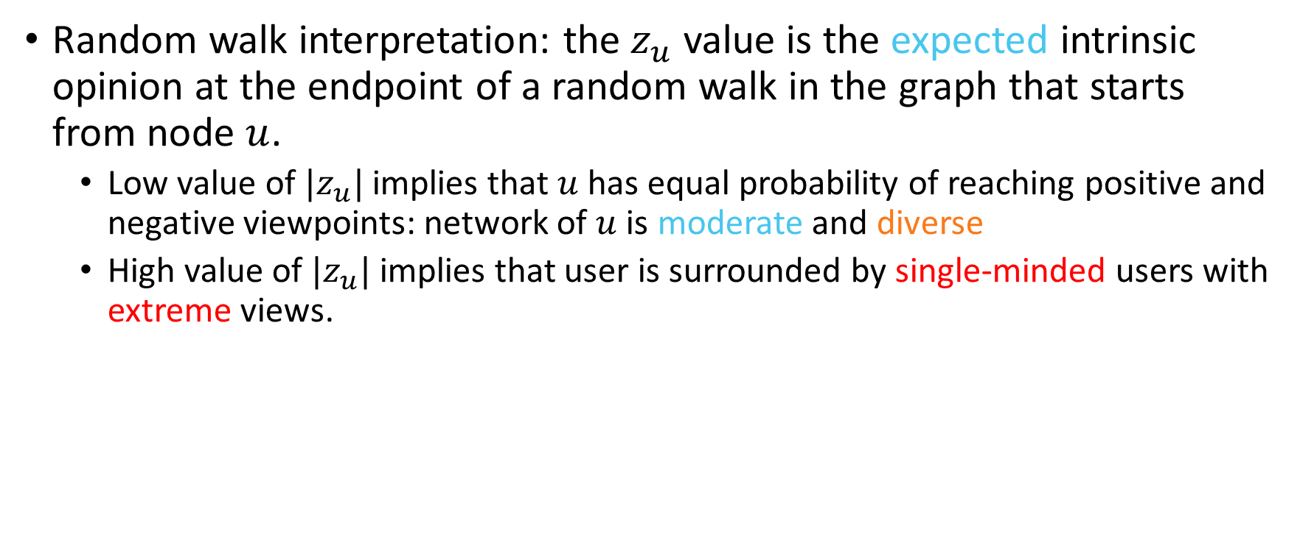
Polarization index interpretation
Random walk interpretation: the$z_{u}$ value is the expected intrinsic opinion at the endpoint of a random walk in the graph that starts from node $u$.
  Low value of ${|z}_{u}|$ implies that $u$has equal probability of reaching positive and negative viewpoints: network of $u$ is moderate and diverse
  High value of ${|z}_{u}|$ implies that user is surrounded by single-minded users with extreme views.

Slide 45
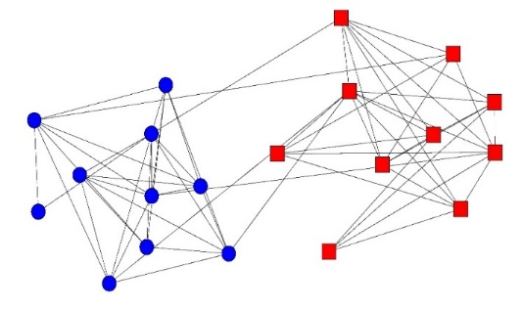
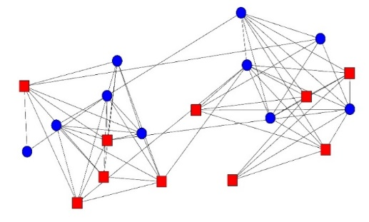
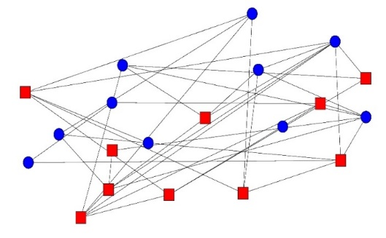
Examples
Echo chamber graph
Polarization Index: 0.30
Community structure with random opinions
Polarization Index: 0.03
Random graph
Polarization Index: 0.03
The polarization index captures echo-chambers in the network.

Slide 46
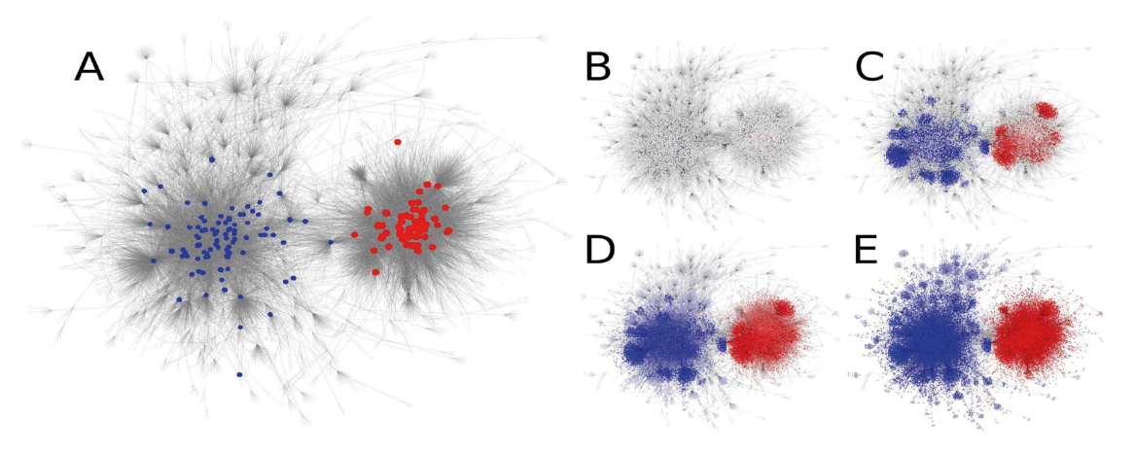
Label propagation
Morales, Borondo, Losada, and Benito. “Measuring political polarization: Twitter shows the two sides of Venezuela.” Chaos. 2015.
Opinion formation:
  Identify a set of ‘seed’ users and propagate until convergence
Measure: distance between distributions
  “Dipole moment”
  Accounts for the mass of the population
Notes:
Maybe we should also mention Ashish goels pnas paper on disagreement?

Slide 47
Mitigating polarization

Slide 48
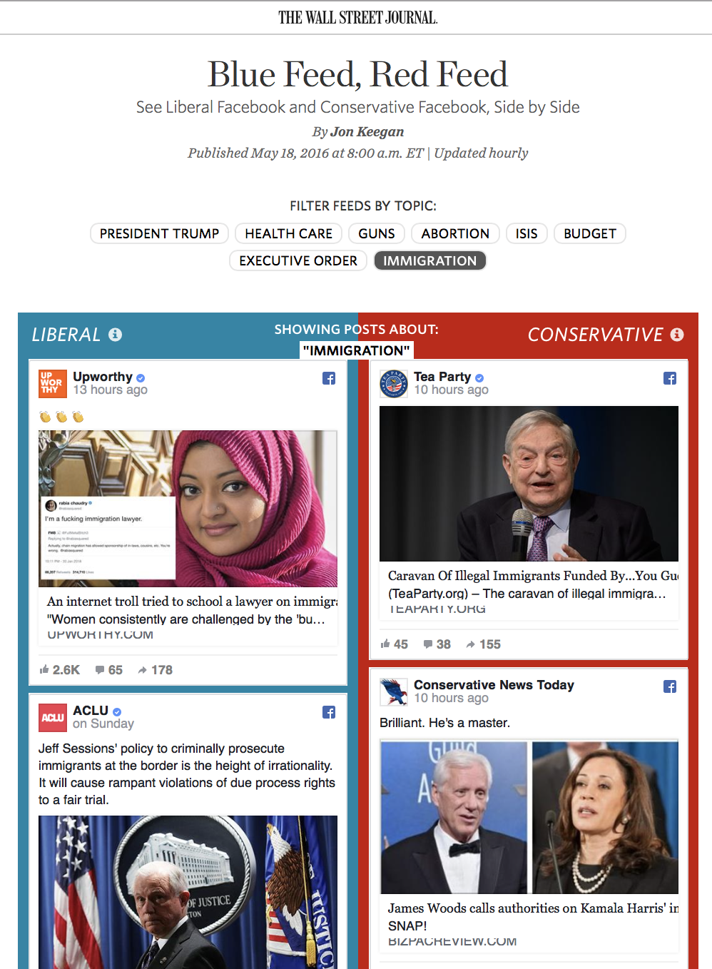
Wall Street Journal
Blue Feed, Red Feed
Curated by the newspaper
Aims to show how different the facebook feed can be for different users

Slide 49
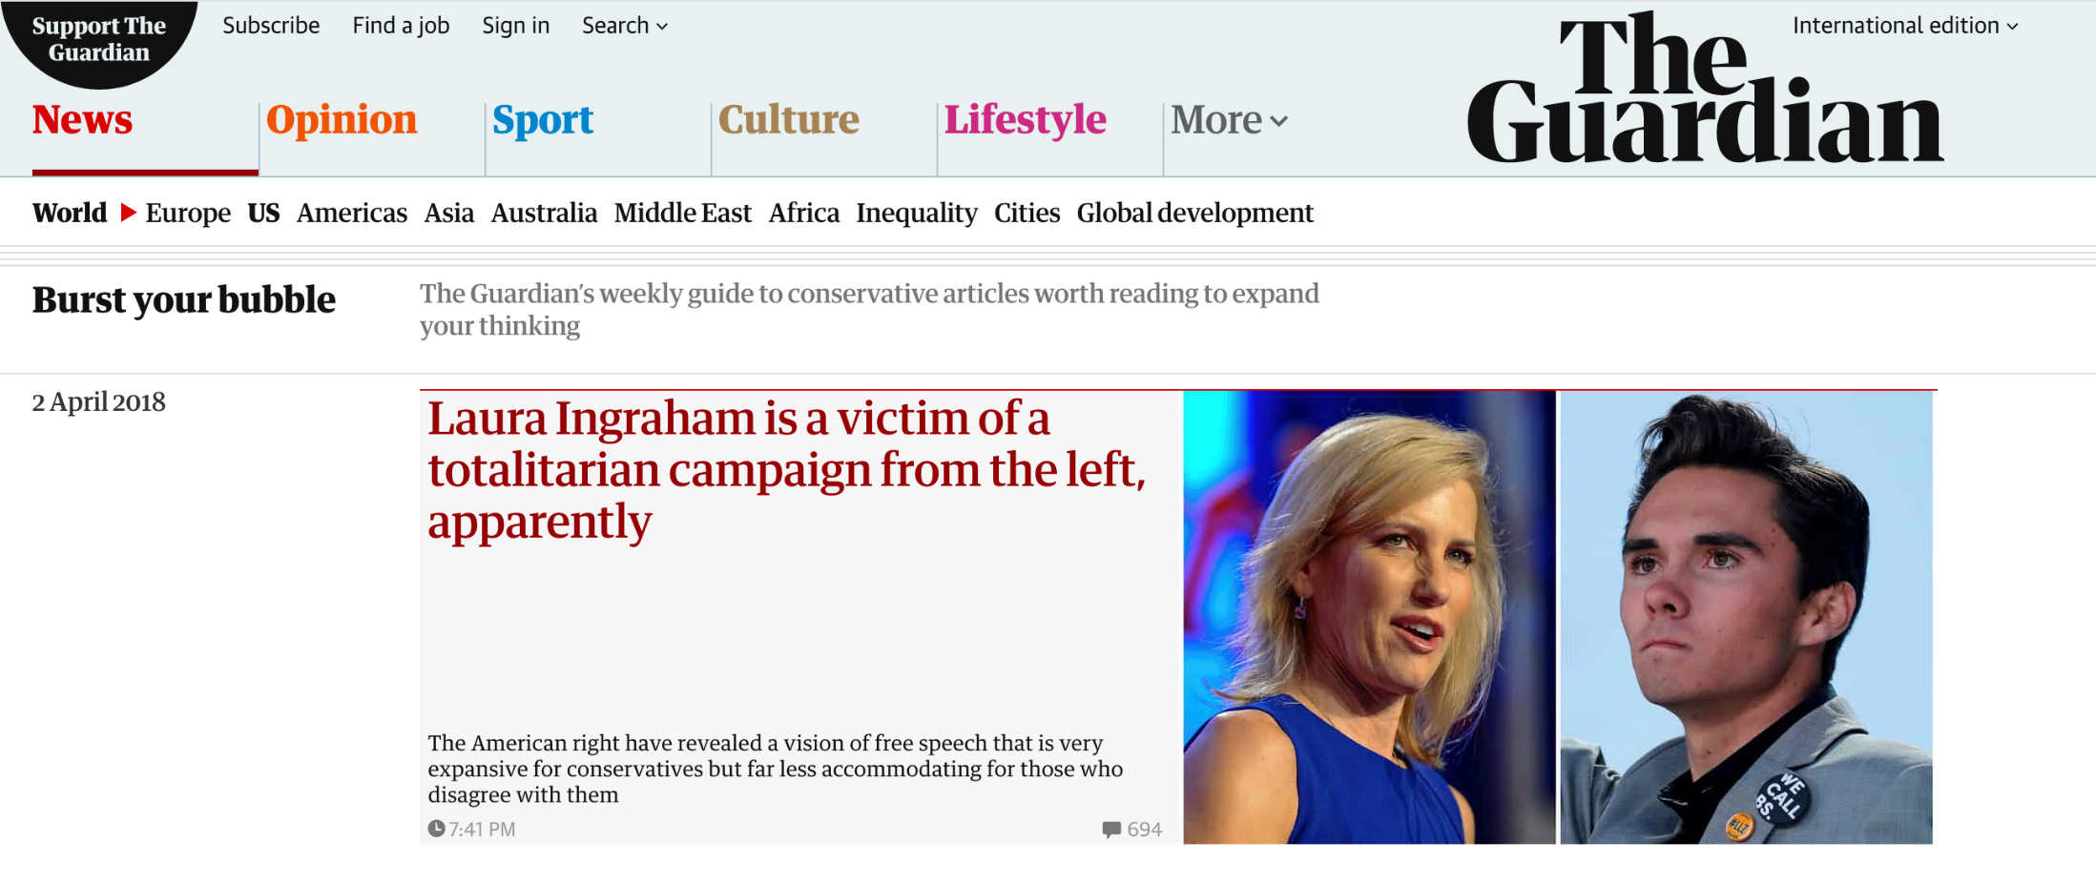
Burst your bubble by the guardian
The Guardian is left-wing
The column shows selected conservative articles from around the web

Slide 50
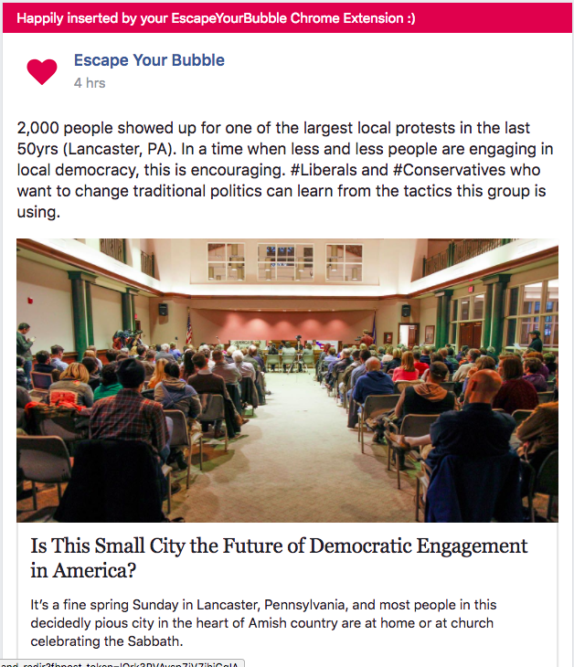
Escape your bubble
Browser (chrome) extension
Asks you which type of people you would like to be more accepting to
App inserts human-curated, positive articles and images into Facebook News Feed, which paint those you would like to be more accepting of in a positive light

Slide 51
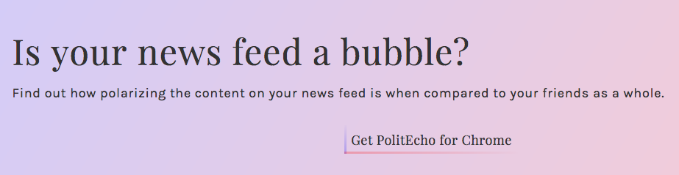
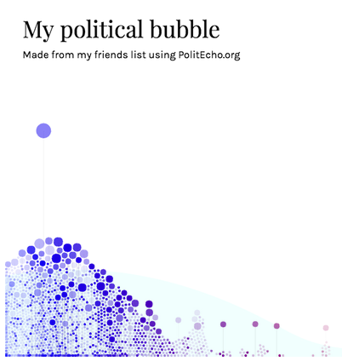
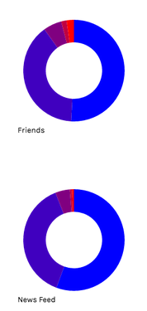
politecho.org
Browser (chrome) extension
Shows political distribution of own Facebook feed vs. that of friends
Compares liked political pages with a reference set of political pages

Slide 52
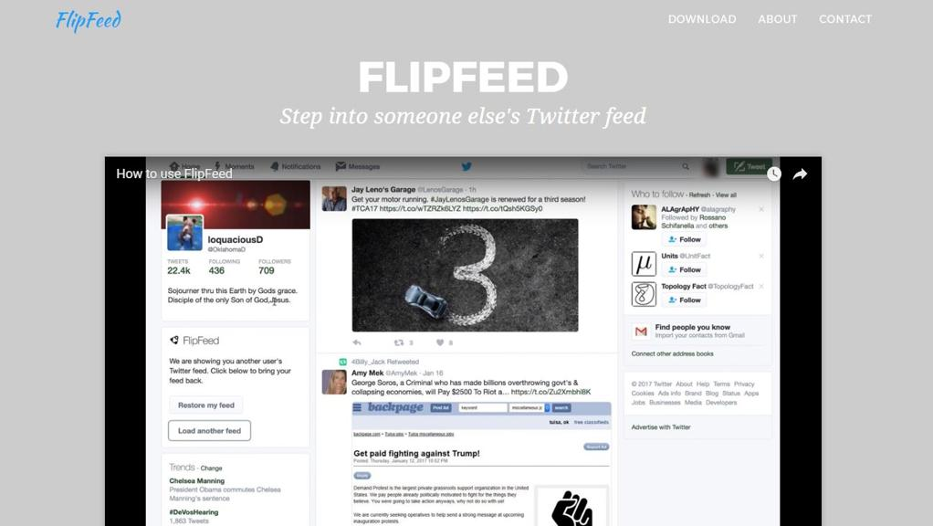
Browser (chrome) extension
Allows Twitter users to see a feed that resembles that of another user who has been pre-classified as right- or left-leaning
Laboratory for Social Machines at MIT Media Lab

Slide 53
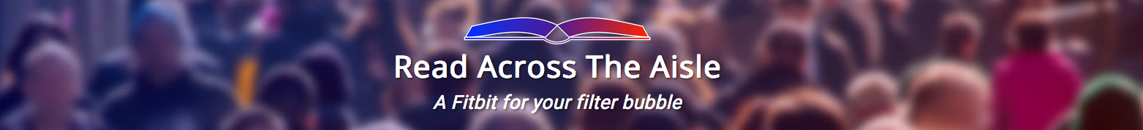
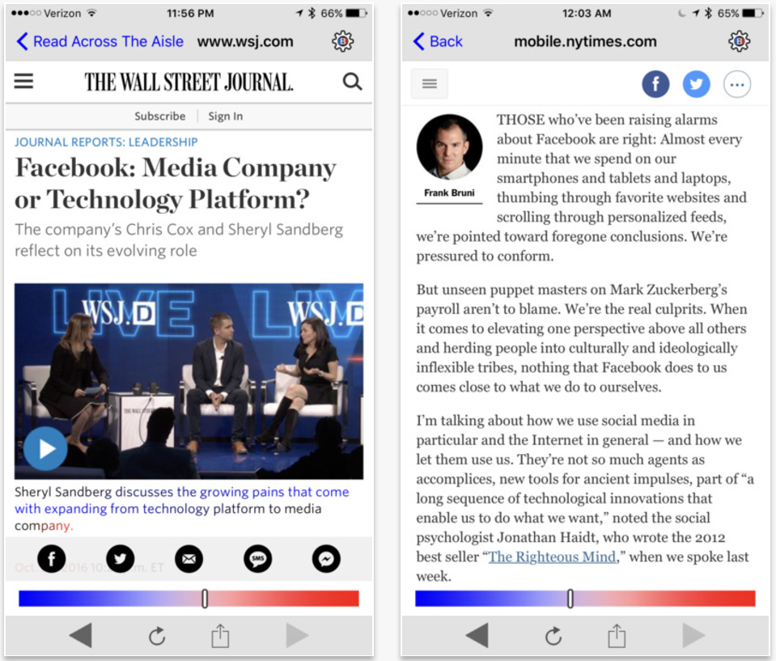
Read across the aisle
Mobile (iPhone) app and chrome extension
News reader for select sources
Keeps track of personal reading history
Informs user of news diet bias

Slide 54
Algorithmic mediation/recommendations
Task : make a recommendation helping to reduce polarization
Different approaches driven by polarization metrics
  Pick a favorite metric : RWC, opinion diversity, influence-based
  Compute recommendation that reduces polarization according
    to the selected metric
  Account for recommendation acceptance probability
Another dimension: What to recommend? User vs. content

Slide 55
1. Recommendations based on RWC
Recall : random-walk controversy score
Quantifies the degree of polarization of a given topic
Based on the structure of the retweet graph of the topic

Slide 56
1. Recommendations based on RWC
Assuming : polarization is measured by RWC
Problem : add k edges to maximally reduce RWC
Enhance greedy with efficient incremental computation
Edge additions are interpreted as recommendations
Incorporate probability of accepting a recommendation
  compute user polarity, and
  acceptance probability as a function of user polarity
K. Garimella et al. “Reducing controversy by connecting opposing views”. WSDM 2017

Slide 57
Reducing polarization : real example
Polarity = − 0.99
Polarity = 0.95

Slide 58
Reducing polarization : real example
Polarity = − 0.99
Polarity = 0.15

Slide 59
Reducing polarization : results
Ignoring acceptance probabilities
With
acceptance
probabilities
K. Garimella et al. “Reducing controversy by connecting opposing views”. WSDM 2017

Slide 60
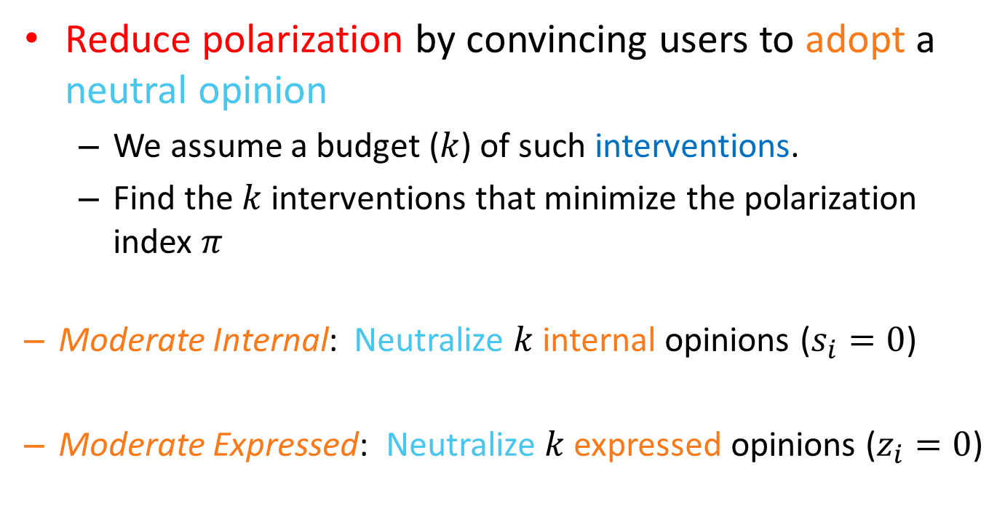
Reducing the polarization index
Reduce polarization by convincing users to adopt a neutral opinion
  We assume a budget ($k$) of such interventions.
  Find the $k$interventions that minimize the polarization index $π$
  Moderate Internal: Neutralize $k$internal opinions ($s_{i}=0$)
  Moderate Expressed: Neutralize $k$expressed opinions ($z_{i}=0$)

Slide 61
Moderating opinions – Example
s = +1
s = -1
s = +1
s = -1
s = -1

Slide 62
Moderating opinions - Example
Moderate Internal
Moderate Expressed
s = +1
s = +1
s = -1
s = -1
s = +1
s = +1
z = 0
s = -1
s = 0
s = -1

Slide 63
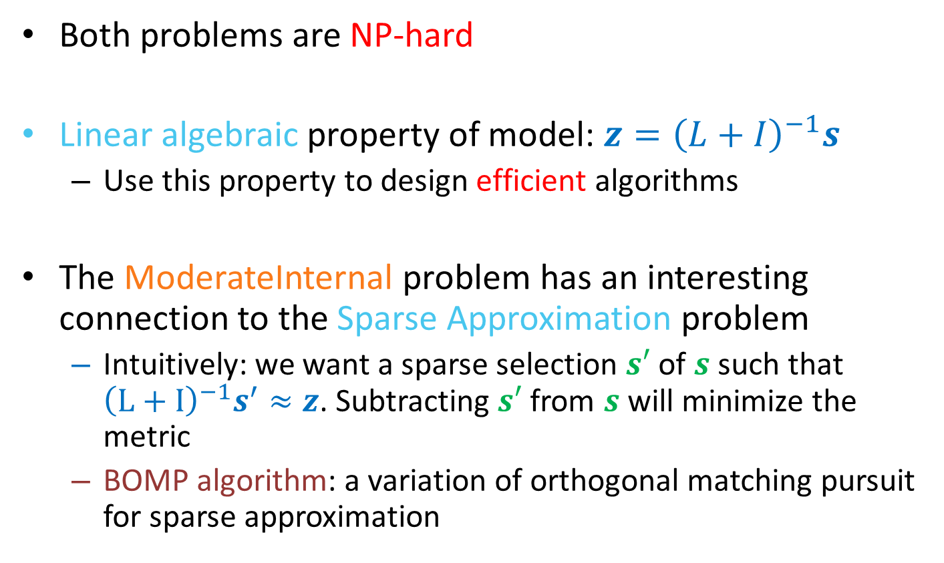
Algorithms
Both problems are NP-hard
Linear algebraic property of model: $z={\left(L+I\right)}^{−1}s$
  Use this property to design efficient algorithms
The ModerateInternal problem has an interesting connection to the Sparse Approximation problem
  Intuitively: we want a sparse selection $s′$ of $s$ such that ${\left(L+I\right)}^{−1}s^{′}≈z$. Subtracting $s′$ from $s$ will minimize the metric
  BOMP algorithm: a variation of orthogonal matching pursuit for sparse approximation

Slide 64
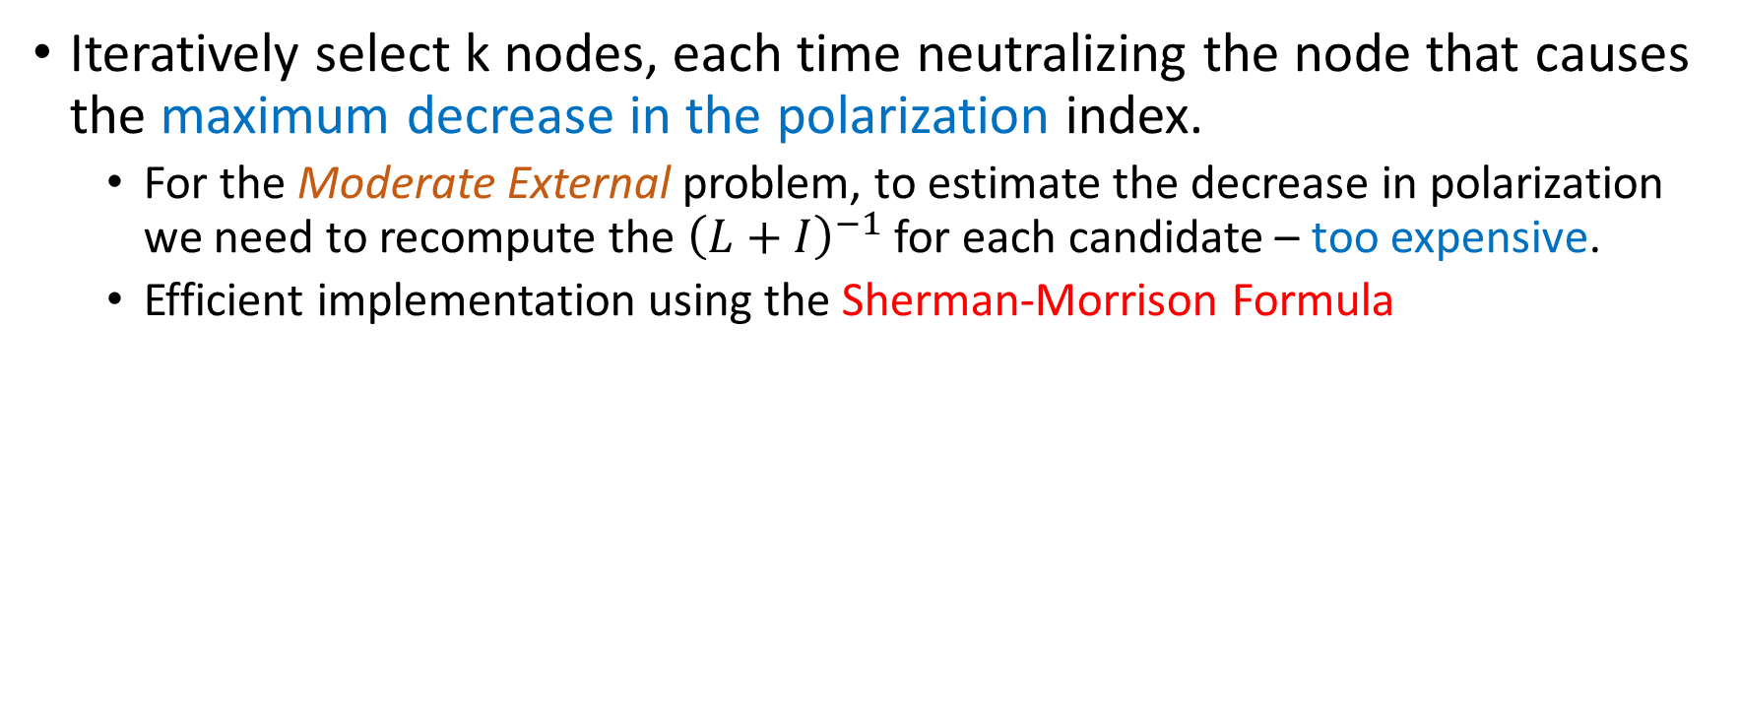
Greedy algorithms
Iteratively select k nodes, each time neutralizing the node that causes the maximum decrease in the polarization index.
  For the Moderate External problem, to estimate the decrease in polarization we need to recompute the ${\left(L+I\right)}^{−1}$ for each candidate – too expensive.
  Efficient implementation using the Sherman-Morrison Formula

Slide 65
Heuristics for opinion moderation
ExtremeExpressed: At each step neutralize the node with the highest expressed opinion.
ExtremeNeighbors: At each step neutralize the node whose neighbors have the highest absolute sum of expressed opinions
Pagerank: Select the nodes in decreasing order according to their PageRank value

Slide 66
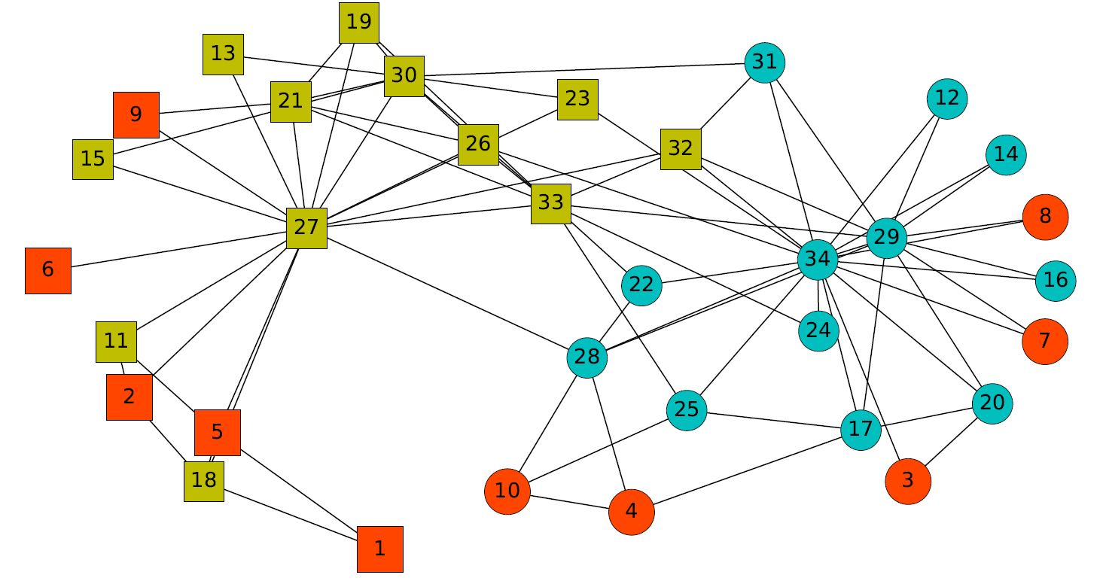
Selected nodes by GreedyInt

Slide 67
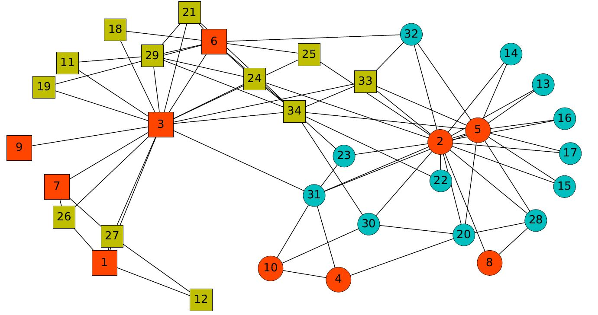
Selected nodes by GreedyExt

Slide 68
Recommendations based on information propagation models
Recall the classic viral-marketing setting
  Given a social network and a propagation model
  e.g., independent-cascade model
  an action (e.g., meme) propagates in the network
The influence-maximization problem
  find k seed nodes to maximize spread
The standard solution
  spread is non-decreasing and submodular
  greedy gives (1−1/e) approximation

Slide 69
Balancing information exposure
Proposed setting
  a social network and two campaigns
  seed nodes I1 and I2 for the two campaigns
  a model of information propagation
The problem of balancing information exposure
  find additional seeds S1 and S2, with |S1| + |S2| ≤ k
  s.t. minimize # of users who see only one campaign
  or maximize # of users who see both or none
K. Garimella et al. “Balancing information exposure in social networks”. NIPS 2017

Slide 70
Algorithmic Fairness
Algorithmic Fairness in Machine Learning
Algorithmic Fairness in Networks

Slide 71
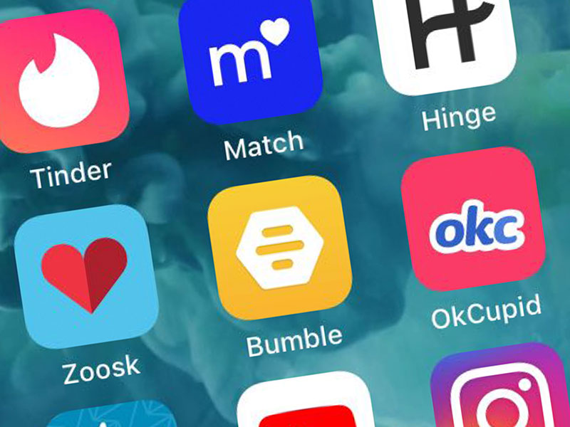
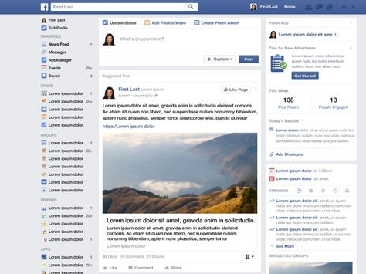





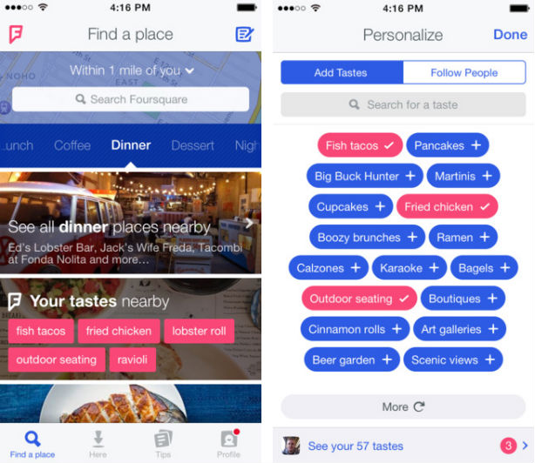
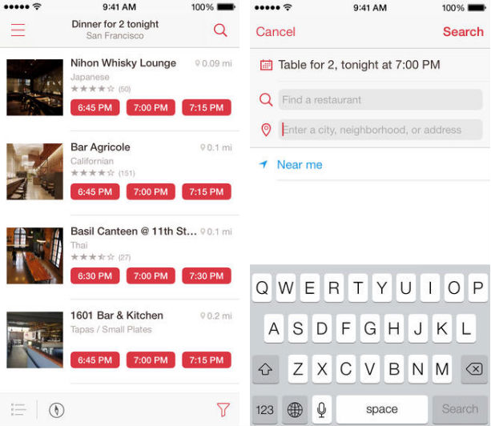
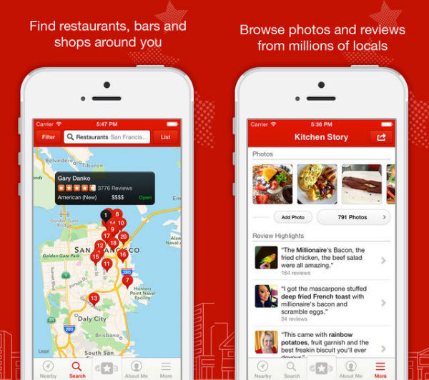


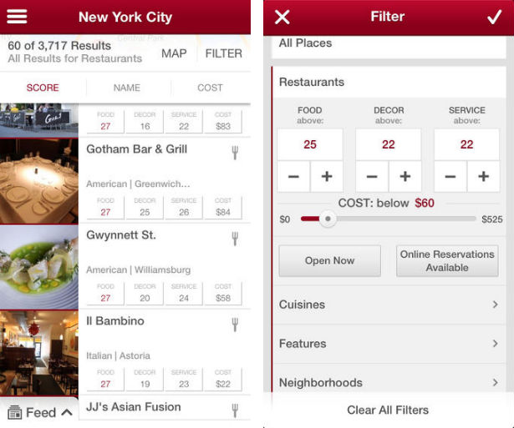





Algorithmic Fairness: Why?
We live in a world where opinions are formed, and decisions are assisted or even taken by AI algorithms: often black boxes; driven by enormous amount of data
From simple, or not that simple, personal ones
Who to date?
What is happening in the world?
Where to dine?
What to read, watch, buy..?
Get informed, learn?
Which job to take? Which school to attend? Whom to follow? Whom to vote…? ..?
Shape our opinions and our view of the world

Slide 72






Algorithmic Fairness: Why?
And not just by individuals:
Medicine: prognosis, diagnosis, treatment recommendation
Insurance, Credit, Benefit (resource) allocation, Housing
Pricing of goods and services
Education, e.g., school admission
Law enforcement, e.g., sentencing decisions
Job recruitment
Raise several concerns

Slide 73
And this concern has not been without reason:
a steady stream of empirical findings has shown that data-driven methods can unintentionally both encode existing human biases and introduce new ones.
A Snapshot of the Frontiers of Fairness in Machine Learning
By Alexandra Chouldechova, Aaron Roth
Communications of the ACM, May 2020, Vol. 63 No. 5, Pages 82-89

Slide 74
Case Studies

Slide 75


Algorithmic (Un)Fairness: Examples
Example: The COMPAS recidivism prediction⁽¹⁾
Commercial tool that uses a risk assessment algorithm to predict some categories of future crime
Used in courts in the US for bail and sentencing decisions
Study by ProPublica
⁽¹⁾ https://www.propublica.org/article/machine-bias-risk-assessments-in-criminal-sentencing

Slide 76

Algorithmic (Un)Fairness: Examples
Example: Word Embeddings⁽²⁾
representation of words/texts as a vector of numbers
  Banana →(0.3, 5.8, 7.3, 0.1)
  Father →(0.4, 0.7, 1.2, 0.4)
  Baby → (0.3, 0.6, 1.5, 3.0)
  Why? Algorithms work with numbers.
Trained on a corpus of Google News texts
The trained embedding exhibit female/male gender stereotypes, learning that "doctor" is more similar to man than to woman
Such embeddings as input to downstream ML tasks
⁽²⁾ Bolukbasi et al. "Man is to computer programmer as woman is to homemaker? debiasing word embeddings." Advances in Neural Information Processing Systems (2016).

Slide 77
Algorithmic (Un)Fairness: Examples
Example: Amazon recruitment ⁽³⁾
In 2015, Amazon realized that their algorithm used for hiring employees was biased against women
  algorithm was based on the number of resumes submitted over the past ten years
  most of the applicants were men, it was trained to favor men over women.
Example: Dutch Tax authority fraud risk assessment⁽⁴⁾
Dutch tax authorities use a self-learning algorithm to create risk profiles to spot childcare benefits fraud.
The criteria for the risk profile were developed by the tax authority, having dual nationality was marked as a big risk indicator, as was a low income.
The Dutch tax authorities faces a €3.7 million fine
⁽³⁾ https://www.theguardian.com/technology/2018/oct/10/amazon-hiring-ai-gender-bias-recruiting-engine
⁽⁴⁾ https://www.politico.eu/article/dutch-scandal-serves-as-a-warning-for-europe-over-risks-of-using-algorithms/

Slide 78


Algorithmic (Un)Fairness: Examples
Example: Image Search⁽⁵⁾
What images do people choose to represent careers?
E.g., percentage of images portraying women in image search for professions
In search results:
evidence for stereotype exaggeration
systematic underrepresentation of women (compared with the actual percentage as estimated by the US bureau of labor and statistics)
⁽³⁾ Matthew Kay, Cynthia Matuszek, and Sean A Munson. Unequal representation and gender stereotypes in image search results for occupations. CHI 2015

Slide 79
Algorithmic (Un)Fairness: Examples
Example: Health care risk assessment
Black patients lose out on critical care when systems equate health needs with costs ⁽⁶⁾
Used on more than 200 million people in US
  identify which patients will benefit from “high-risk care management” programs: access to specially trained nursing
Heavily favored white patients over black patients
  Race wasn’t a variable, but healthcare cost history […]
  Black patients incurred lower health-care costs than white patients with the same conditions on average
Among all patients classified as very high-risk, black individuals turned out to have 26.3 percent more chronic illnesses than white ones
⁽⁶⁾ https://www.scientificamerican.com/article/racial-bias-found-in-a-major-health-care-risk-algorithm/

Slide 80
Examples
Algorithmic (Un)Fairness: Examples
Jobs ads⁽⁷⁾
Facebook Inc. disproportionately shows certain types of job ads to men and women.
Job ads were more likely to present job ads to users if their gender identity reflected the concentration of that gender in a particular position or industry
(study led by University of Southern California researchers)
Example:
Ads for delivery driver job listings that had similar qualification requirements but for different companies.
The ads did not specify a specific demographic.
One was an ad for Domino’s pizza delivery drivers, the other for Instacart drivers.
Instacart has more female drivers but Domino’s has more male drivers.
Facebook targeted the Instacart delivery job to more women and the Domino’s delivery job to more men.
⁽⁷⁾ https://www.wsj.com/articles/facebook-shows-men-and-women-different-job-ads-study-finds-11617969600
Notes:
Example:
Ads for delivery driver job listings that had similar qualification requirements but for different companies. The ads did not specify a specific demographic.
One was an ad for Domino’s pizza delivery drivers, the other for Instacart drivers.
Instacart has more female drivers but Domino’s has more male drivers.
Facebook targeted the Instacart delivery job to more women and the Domino’s delivery job to more men.

Slide 81


Examples
Algorithmic (Un)Fairness: Examples
Facial recognition technology⁽⁸⁾
Last year, he was accused of reaching into a vehicle, grabbing a cellphone from a man and damaging it.
Officials concluded Oliver had been misidentified as the perpetrator and dismissed the case.
Detroit Police used facial recognition technology in the investigation.
Facial recognition systems have been used by police forces for more than two decades.
While the technology works relatively well on white men, the results are less accurate for other demographics
(Recent studies by M.I.T. and the National Institute of Standards and Technology)
In part because of a lack of diversity in the images used to train the algorithm.
⁽⁸⁾ https://eu.freep.com/story/news/local/michigan/detroit/2020/07/10/facial-recognition-detroit-michael-oliver-robert-williams/5392166002/

Slide 82
Bias

Slide 83

What is the cause of unfairness: bias
Bias
Overloaded term used to capture various forms of misusing data and information, prejudice behavior, and favoritism.
Also, various interpretations in ML
According to Oxford English Dictionary
an inclination, or prejudice for, or against one person, or group, especially in a way considered to be unfair
Two different types
Statistical
Societal

Slide 84
What is the cause of unfairness: bias
Statistical bias
Non-representative sampling: mismatch between the sample/data used to train a predictive model, and the world as it currently is.
Sampling bias: the dataset selected as input to an algorithm is not representative of the full population to which the algorithm will be applied.
For example, missing MRI scans of healthy people, cardiovascular diseases for women
Selective labels (selection bias): the observed outcome depends on the choice of input.
For example, evaluating whether a loan will be repaid
Systematic measurement error, particularly when the error is greater for some groups than others
S. Mitchell, E. Potash, S. Barocas, A. D’Amour, and K. Lum. 2020. Prediction-based decisions and fairness: A catalogue of choices, assumptions, and definitions. Annual Review of Statistics and Its Application 2021 8:1

Slide 85
What is the cause of unfairness: bias
Statistical Bias
What is bias?
Societal bias
objectionable social structures, human biases, and preferences that are:
reflected in data,
when designing, implementing, evaluating and using algorithms and systems.
Long list of biases: confirmation bias, normative biases, functional biases induced by the platforms, behavioral and temporal biases, cognitive biases
A. Olteanu, C. Castillo, F. Diaz, and E. Kiciman. 2019. A critical review of online social data: Biases, methodological pitfalls, and ethical boundaries. Front. Big Data 2, 13 (2019).

Slide 86
What is the cause of unfairness: bias
Bias may come from:
the actual data (garbage in, garbage out)
  if a survey contains biased questions [societal bias]
  if some specific population is misrepresented in the input data [statistical bias]
    Sample size disparity: learn on majority, errors concentrated in the minority class
  if the data itself is a product of a historical process that operated to the disadvantage of certain groups - data as a social mirror [societal bias]
the algorithm
  reflecting, for example, commercial or other preferences of its designers [societal bias]
  data processing [statistical bias]
  feedback loop [bias amplification] an algorithm receives biased data produces more biased output data and when this output data are fed back to this, or some other algorithm, bias keeps increasing in an endless feedback loop

Slide 87
Fairness Definitions

Slide 88


Algorithmic Fairness: What?
Fairness is a general term, an elusive goal
Philosophical, ethical, political, judicial interpretations
Equality
Treat everyone the same
Equity
Treat everyone according to their needs
No barriers
(*) https://www.vocabulary.com/dictionary/fairness

Slide 89
Algorithmic Fairness: What?
Algorithmic fairness: Lack of discrimination
the results of an algorithm should not be influenced by protected, or sensitive attributes, such as gender, religion, age, sexual orientation, race, etc
Two levels:
Individual fairness: Similar individuals should be treated in a similar manner
Group fairness: Individuals are partitioned into groups according to their protected attributes. All groups should be treated fairly/similarly.
Depends on the algorithm: Classification, Recommendation, Ranking, Set Selection, Clustering, etc

Slide 90
Classification

Slide 91

Individual Fairness
Distance-based
Define a distance $d$ between individuals and a distance $D$ between the output
$$D\left(O\left(x\right), O\left(y\right)\right) \sim d\left(x,y\right)$$
How to define distances, especially in the input space
Cynthia Dwork, Moritz Hardt, Toniann Pitassi, Omer Reingold, Richard S. Zemel: Fairness through awareness. ITCS 2012: 214-226

Slide 92

Individual Fairness
Similarity of input
$V$ be a set of individuals.
Distance metric d: V$× V → R$
    Task-specific
Expresses ground truth (or, best available approximation)
Externally imposed, e.g., by a regulatory body, or externally proposed, e.g., by a civil rights organization
Made public, and open to discussion and refinement.
x
d(x, y)
y

Slide 93



Individual Fairness
Similarity of outcome
Probabilistic classifier $M$ that maps individuals in $V$ to probability distributions over outcomes A
To classify x ∈ V, we choose an outcome a ∈ A according to distribution M(x)
Lipschitz Mapping: a mapping M: V -> Δ(Α) satisfies the (D, d)-Lipschitz property, if for every x, y ∈ V, $D\left(M\left(x\right)−M\left(y\right)\right)≤L d\left(x,y\right)$
where D is a distance measure between probability distributions

Slide 94

Group Fairness
Individuals divided into groups based on the value of one or more protected attribute
Two groups
$G^{+}$ : Protected (minority) group
$G^{−}$ : Non protected (privileged) group

Slide 95



Group Fairness
Classification
Output
$\hat{Y}$ = 1
Binary classifier
1 is the positive class (i.e., the class that leads to a favorable decision, e.g., getting a job, or being offer a specific medical treatment)
$\hat{Y}$ = 0
$Y$ the actual output - ground truth
$\hat{Y}$ the predicted output
$S$ the predicted probability for a specific output

Slide 96

Group Fairness: parity
Compare the probability of a favorable outcome for the non-protected group with the probability of a favorable outcome for the protected group
$$\frac{P\left[\hat{Y}=1 \right|v∈G^{+}] }{P\left[\hat{Y}=1 \right|v ∈ G^{−}] }=1$$
demographic parity (statistical parity, independence)
preserves the input ratio: the demographics of the individuals receiving a favorable outcome the same as demographics of the underlying population
If there 10% of women among the applicants, 10% of those getting the job are women
Equity, or equality of output: members of each group have the same chance of getting the favorable output.
Instead of equal, some other value, e.g., 80% rule, or disparate impact

Slide 97



Group Fairness: error-based
Confusion Matrix
Both the predicted output $\hat{Y}$ and the actual output $Y$
Actual
 | $Y$ = 1 | $$Y=0$$
$$\hat{Y}=1$$ | TP | FP
$$\hat{Y}=0$$ | FN | TN
Predicted
For example:
Knows as equal opportunity
$$P\left[\hat{Y}=1 \right|Y=1, v∈G^{−}]$$
TP (true positive) rate for the non-protected group
$$P\left[\hat{Y}=1 \right|Y=1, v∈G^{+}]$$
TP rate for the protected group
equal opportunity vs statistical parity: as with statistical parity, the members of the two groups have the same chance of getting the favorable outcome, but only when these members qualify
Equal opportunity is closer to an equality interpretation of fairness
Equalized odds: both true and false positive rates equal for the two groups

Slide 98

Group Fairness: calibration
In probabilistic classifiers where the output is the probability that an individual belongs to the positive class), we want the estimates to be well-calibrated:
if the algorithm identifies a set of people as having a probability $p$ of belonging to the positive class, then approximately a p fraction is indeed positive instances
We want the classifier to be equally well-calibrated for both groups, for any predicted probability p in [0,1]:
$P\left[Y=1 \right|S=p, v∈G^{−}]=P\left[Y=1 \right|S=p, v∈G^{+}$]

Slide 99
Group Fairness (other names)
Independence (demographic parity)
Separation (error rates)
Sufficiency (calibration)

Slide 100
Counterfactual Fairness
A decision is fair towards an individual, if it is the same in both the actual world and a counterfactual world where the individual belonged to a different group
Individual fairness Two data points
Group fairness Two demographic groups
Counterfactual fairness A data point and its counterfactual
Casual inference

Slide 101
ACHIEVING FAIRNESS

Slide 102
Achieving Fairness: How
In general, there are three approaches to achieving fairness:
  Pre-processing: Preprocess the data
  In-processing: Change the algorithm
  Post-processing: Tweak the output
Input
Algorithm
Output

Slide 103

Pre-processing : omit the protected attribute
Blindness/Unawareness: omit/hide the value of the protected attribute
Other proxy attributes correlated with the protected ones (also known as redundant encoding).
Redlining: the practice of arbitrarily denying or limiting financial services to specific neighborhoods
(based on zip codes (*))
(*) Amazon doesn’t consider the race of its customers. Should It? Ingold, D. and Soper, S., 2016. Bloomberg News.
Notes:
Redlining: the practice of arbitrarily denying or limiting financial services to specific neighborhoods, generally because its residents are people of color or are poor.“, well-known form of discrimination based on redundant encoding. Illegal in the US

Slide 104
Pre-processing: overview
bias in rows
bias in columns
fairness
algorithm
Suppression
Class Relabeling
Reweighing
Data Transformation
Database Repair
Data Augmentation
✔️
group
any
remove data
✔️
group
ranker
✔️
individual / group
ranker
✔️
individual / group
ranker
modify data
✔️
✔️
group
ranker
✔️
✔️
individual / group
matrix factorization
add data
recommender-oriented
Bias in the rows
when there are not enough representative individuals from minority (sub)groups
Bias in the columns
when features are biased (correlated) with sensitive attributes.

Slide 105
Pre-processing: Class relabeling
Changes the labels of some objects in the dataset to remove the discrimination from the input data.
The method:
Consider a subset of data from the minority group as promotion candidates,
and a subset of the majority group is chosen as demotion candidates.
How to select candidates:
Learn a classifier; rank the tuples based on their probability of having positive labels
Select the top k of minority (for promotion) and the bottom k of majority (for demotion)
Flip their labels
Lowering the discrimination will result in lowering the accuracy and vice versa
Intrusive

Slide 106
In-processing: Overview
In-processing: Overview
Depends on the algorithm
Common approaches in learning based:
Learning fair representations
Adding regularization terms to the objective function

Slide 107
In-processing: learning fair representations
Basic idea:
Introduce an intermediate level Z between the input space X that represents individuals and the output space Y that represents classification outcomes
Z: representation of X
    best encodes X and
obfuscates any information about membership in the protected group
X
Z
Y
Input: individuals
Fair representation
Classification output
Z is a multinomial random variable of size k where each of the k values represents a prototype (cluster) in the space of X.
As in pre-processing, but now part of the optimization objective

Slide 108


In-processing: learning fair representations
A learning system that minimizes the loss function
Quality of the encoding
X
Z
Y
Fairness
Accuracy
$$L= λ_{x}L_{x}+ λ_{z}L_{z}+λ_{y}L_{y}$$
Input: individuals
Fair representation
Classification output
Distance from points in X to their representation in Z should be small
Statistical parity
Prediction based on the representation should be accurate
$λ_{x}$, $λ_{z}, λ_{y}$ hyper-parameters that control the trade-off among the three objectives
Statistical parity
$P\left(z=k\right|x ∈G^{+})=P(z=k| x∈G^{−})$ $∀ k$
The probability that a random element of the protected group maps to a particular prototype of $Z$ is equal to the probability that a random element of the non-protected group maps to the same prototype

Slide 109

In-processing: learning fair representations
Adversarial leaning
Simultaneously two goals:
(1) Predictor Accuracy
(2) Fοοl the Αdversary
The adversary is trying to predict the relevant sensitive variable from the representation, and so minimizing the performance of the adversary ensures there is little or no information in the representation about the sensitive variable.

Slide 110

In-processing: Regularization
$$L= L_{original}+λ L_{fairness}$$
The DELTR approach extends the ListNet learning to rank approach
$L_{DELTR}\left(r\left(q\right),\hat{r}\left(q\right)\right)= L_{LN}\left(r\left(q\right),\hat{r}\left(q\right)\right)+λ F(\hat{r}\left(q\right)$)
Unfairness
Accuracy
λ specifies the desired trade-offs between ranking utility and fairness
$$F\left(\hat{r}\left(q\right)\right)=max⁡(0, (Exposure\left(G^{+} | P_{\hat{r}\left(q\right)}\right)−Exposure\left(G^{−} | P_{\hat{r}\left(q\right)}\right))^{2})$$
squared hinge loss: if the protected group already receives as much exposure as the non-protected, just optimize for accuracy
prefers rankings in which the exposure of the protected group is not less than the exposure of the non protected group but not vice versa

Slide 111

Post-Processing: Constraint optimization
As an optimization problem
$F$: a fairness measure
$U$: a measure of the utility (accuracy)
There are two general ways of formulating an optimization problem involving fairness F and utility U namely:
maximizing fairness subject to a constraint in utility
maximizing utility subject to a constraint in fairness

Slide 112
FAIRNESS in NETWORKS
Many thanks to Jian Kang and Hanghang Tong from UIUC for generously sharing their tutorial slides

Slide 113




Graph Mining: Applications
Financial fraud detection
Credit scoring
User community detection
Identifying influencers

Slide 114


Algorithmic Fairness on Graphs: Suicide Prevention
Suicide is one of the leading causes of death in US
Observation: existing suicide prevention efforts disproportionately affect individuals of different demographics
Gatekeeper training
programs
Toy example of a gatekeeper
training program
Suicide attempts
by race/ethnicity
[1] https://www.cdc.gov/nchs/data/vsrr/vsrr024.pdf
[2] https://988lifeline.org/
[3] https://www.childtrends.org/publications/addressing-discrimination-supports-youth-suicide-prevention-efforts

Slide 115


Challenge
Assumption
  IID: independent and identically distributed
Example
Challenges: implication of non-IID nature on
  Measuring bias
    Dyadic fairness, degree-related fairness
  Mitigating unfairness
    Enforce fairness by graph structure imputation
 | Classic machine learning | Graph mining
Data | IID samples | Non-IID graph
Individuals are independent
Cannot affect others
Individuals are connected
Can affect others through connection(s)
Classic machine learning
Graph mining

Slide 116
Roadmap
Network Centrality Fairness
Fair Graph Embeddings

Slide 117

The Pagerank Algorithm
The best-known algorithm for measuring the centrality/importance of nodes in a graph, introduced by Google
Assumption: important webpage → linked by many others
Pagerank performs a random walk with restarts:
At each step of the random walk:
  With probability $c$ perform a transition according to the transition probability matrix $A$
  With probability $1−c$ restart to a randomly selected node according to teleportation (jump) vector $e$
The Pagerank vector is the stationary distribution $r$ of this random walk

Slide 118

Preliminary: PageRank
Formulation
  Iterative method for the following linear system
  $$r=cA^{T}r+\left(1−c\right)e$$
    $A$: transition matrix
    $r$: PageRank vector
    $c$: damping factor
    $e$: teleportation vector
  Closed-form solution
  $$r=\left(1−c\right){\left(I−cA^{T}\right)}^{−1}e$$
Variants
  Personalized PageRank (PPR)
[1] Page, L., Brin, S., Motwani, R., & Winograd, T. (1999). The PageRank Citation Ranking: Bringing Order to the Web. Stanford InfoLab 1999.
[2] Haveliwala, T. H. (2003). Topic-sensitive PageRank: A Context-Sensitive Ranking Algorithm for Web Search. TKDE 2003.
[3] Tong, H., Faloutsos, C., & Pan, J. Y. (2006). Fast Random Walk with Restart and Its Applications. ICDM 2006.

Slide 119

Unfairness in PageRank
Pagerank distributes the importance values to the nodes in the network
  But is it fair?
Example
  Network: 1222 nodes of political blogs
  Groups: red (left-leaning) and blue (right-leaning)
How can we define Pagerank fairness?
How do we make Pagerank fair?
Unfair ranking
Similar number of red nodes vs. blue nodes (48% red vs. 52% blue)
Much less PageRank mass of red nodes (33% red vs. 67% blue)
[1] Tsioutsiouliklis, S., Pitoura, E., Tsaparas, P., Kleftakis, I., & Mamoulis, N. (2021). Fairness-Aware PageRank. WWW 2021.
[2] Tsioutsiouliklis, S., Pitoura, E., Semertzidis, K., & Tsaparas, P. (2022). Link Recommendations for PageRank Fairness. WWW 2022.

Slide 120







Fairness Measure: $φ$-Fairness
Given: (1) a graph $G$; (2) a parameter $φ$
Definition: a PageRank vector is $φ$-fair if at least $φ$ fraction of total PageRank mass is allocated to the protected group
Variants and generalizations
  Statistical parity → $φ=$ fraction of protected group
  Affirmative action → $φ=$ a desired ratio (e.g., 20%)
Example
  Protected group $=$ red nodes
  $φ=1/3$
0.3
0.5
0.2
0.25
0.4
0.35
blue nodes
Not $φ$-fair!
blue nodes
$φ$-fair!
$$0.2<\frac{1}{3}$$
$$0.35≥\frac{1}{3}$$
red nodes
red nodes
[1] Tsioutsiouliklis, S., Pitoura, E., Tsaparas, P., Kleftakis, I., & Mamoulis, N. (2021). Fairness-Aware PageRank. WWW 2021.
[2] Tsioutsiouliklis, S., Pitoura, E., Semertzidis, K., & Tsaparas, P. (2022). Link Recommendations for PageRank Fairness. WWW 2022.

Slide 121

Problem Definition: Fair PageRank
Given
  A graph with transition matrix $A$
  Partitions of nodes
    Red nodes ($ℛ$): protected group
    Blue nodes ($ℬ$): unprotected group
Produce: a fair PageRank vector $\tilde{r}$ that is
  $φ$-fair
  Close to the original PageRank vector $r$ (minimizes the utility loss)
[1] Tsioutsiouliklis, S., Pitoura, E., Tsaparas, P., Kleftakis, I., & Mamoulis, N. (2021). Fairness-Aware PageRank. WWW 2021.
[2] Tsioutsiouliklis, S., Pitoura, E., Semertzidis, K., & Tsaparas, P. (2022). Link Recommendations for PageRank Fairness. WWW 2022.

Slide 122

Fair PageRank: Solutions
Recap: closed-form solution for PageRank
$$r=\left(1−c\right){\left(I−cA^{T}\right)}^{−1}e$$
Parameters in PageRank
  Damping factor $c$ avoids sinks in the random walk (i.e., nodes without outgoing links)
  Teleportation vector $e$ controls the starting node where a random walker restarts
    Can we control where the walker teleports to?
  Transition matrix $A$ controls the next step where the walker goes to
    Can we modify the transition probabilities?
    Can we modify the graph structure?
Solution #1: fairness-sensitive PageRank
[1] Tsioutsiouliklis, S., Pitoura, E., Tsaparas, P., Kleftakis, I., & Mamoulis, N. (2021). Fairness-Aware PageRank. WWW 2021.
[2] Tsioutsiouliklis, S., Pitoura, E., Semertzidis, K., & Tsaparas, P. (2022). Link Recommendations for PageRank Fairness. WWW 2022.

Slide 123




Solution #1: Fairness-sensitive PageRank
Intuition
  Find a teleportation vector $e$ to make PageRank vector $φ$-fair
$$r=Q^{T}e, { Q}^{T}=\left(1−c\right){\left(I−cA^{T}\right)}^{−1}$$
  Keep transition matrix $A$ and $Q^{T}$ fixed
Observation: mass of PageRank $r$ w.r.t. red nodes $ℛ$
$$r\left(ℛ\right)=Q^{T}[ℛ,:]e$$
  $Q^{T}\left[ℛ,:\right]$: rows of $Q^{T}$ w.r.t. nodes in set $ℛ$
(Convex) optimization problem
$${\min_{e}\left\|Q^{T}e−r\right\|}^{2}$$
$$s.t. e\left[i\right]∈\left[0, 1\right],∀i$$
$${ \left\|e\right\|}_{1}=1$$
$${ \left\|Q^{T}[ℛ,:]e\right\|}_{1}=φ$$
  Can be solved by any convex optimization solvers
The fair PageRank $Q^{T}e$ is as close as possible to the original PageRank $r$
The teleportation vector $e$ is a probability distribution
The fair PageRank $Q^{T}e$ is $φ$-fair
[1] Tsioutsiouliklis, S., Pitoura, E., Tsaparas, P., Kleftakis, I., & Mamoulis, N. (2021). Fairness-Aware PageRank. WWW 2021.

Slide 124











Fairness-sensitive PageRank: Example
Settings: $φ=1/3$ and protected node $=$ red node
Original PageRank
Fairness-sensitive PageRank
$$Q^{T}$$
$$e$$
0.55 | 0.3 | 0.2
0.4 | 0.6 | 0.2
0.05 | 0.1 | 0.6
1/3
1/3
1/3
0.35
0.4
0.25
rows w.r.t. blue nodes
Not $φ$-fair!
$$r=Q^{T}e=$$
$$0.25<\frac{1}{3}$$
row w.r.t. red nodes
$$Q^{T}$$
$$\tilde{e}$$
0.55 | 0.3 | 0.2
0.4 | 0.6 | 0.2
0.05 | 0.1 | 0.6
1/4
1/4
1/2
0.31
0.35
0.34
rows w.r.t. blue nodes
$$\tilde{r}=Q^{T}\tilde{e}=$$
$φ$-fair!
row w.r.t. red nodes
$$0.34≥\frac{1}{3}$$
[1] Tsioutsiouliklis, S., Pitoura, E., Tsaparas, P., Kleftakis, I., & Mamoulis, N. (2021). Fairness-Aware PageRank. WWW 2021.

Slide 125

Fairness-sensitive PageRank: Experiment
Observation: the teleportation vector allocates more weight to the red nodes, especially nodes at the periphery of the network
  More likely to (1) restart at red nodes and (2) walk to other red nodes more often
Protected group
Fairness-sensitive PageRank teleportation vector
PageRank
Unprotected group
NOTE: size is proportional to score in the teleportation vector
[1] Tsioutsiouliklis, S., Pitoura, E., Tsaparas, P., Kleftakis, I., & Mamoulis, N. (2021). Fairness-Aware PageRank. WWW 2021.

Slide 126
Fair PageRank: Solutions
Recap: closed-form solution for PageRank
$$r=\left(1−c\right){\left(I−cA^{T}\right)}^{−1}e$$
Parameters in PageRank
  Damping factor $c$ avoids sinks in the random walk (i.e., nodes without outgoing links)
  Teleportation vector $e$ controls the starting node where a random walker restarts
    Can we control where the walker teleports to?
  Transition matrix $A$ controls the next step where the walker goes to
    Can we modify the transition probabilities?
    Can we modify the graph structure?
Solution #2: locally fair PageRank
[1] Tsioutsiouliklis, S., Pitoura, E., Tsaparas, P., Kleftakis, I., & Mamoulis, N. (2021). Fairness-Aware PageRank. WWW 2021.
[2] Tsioutsiouliklis, S., Pitoura, E., Semertzidis, K., & Tsaparas, P. (2022). Link Recommendations for PageRank Fairness. WWW 2022.

Slide 127




Solution #2: Locally Fair PageRank
Intuition: adjust the transition matrix A to obtain a fair random walk
Neighborhood locally fair PageRank
  Key idea: jump with probability $φ$ to red nodes and (1- $φ$) to blue nodes
  Example
1/3
1/4
Protected group
Locally Fair
($φ$= 0.5)
$$x$$
1/2
$$x$$
Unprotected group
1/3
1/4
1/3
1/2
[1] Tsioutsiouliklis, S., Pitoura, E., Tsaparas, P., Kleftakis, I., & Mamoulis, N. (2021). Fairness-Aware PageRank. WWW 2021.

Slide 128






Solution #2: Locally Fair PageRank
Residual locally fair PageRank
  Key idea: jump with
    Equal probability to 1-hop neighbors
    A residual probability $δ$ to the other red nodes
  Example
Residual allocation policies: neighborhood allocation, uniform allocation, proportional allocation, optimized allocation
$$\frac{1−δ}{3}$$
Protected group
Red Nodes
$$δ$$
$$x$$
$$δ+\frac{1−δ}{3}=φ$$
Unprotected group
$$\frac{1−δ}{3}$$
$$1−δ$$
$$\frac{1−δ}{3}$$
Neighborhood allocation: allocate the residual to protected neighbors, equivalent to neighborhood locally fair PageRank
Uniform allocation: uniformly allocate the residual to all protected nodes
Proportional allocation: allocated the residual to all protected nodes proportionally to their PageRank score
Optimized allocation: allocate the residual to all protected nodes while minimizing the difference with original PageRank score
[1] Tsioutsiouliklis, S., Pitoura, E., Tsaparas, P., Kleftakis, I., & Mamoulis, N. (2021). Fairness-Aware PageRank. WWW 2021.

Slide 129



Locally Fair PageRank: Experiment
Observation: PageRank weight is shifted to the blue nodes at boundary
PageRank
Protected group
Neighborhood Locally Fair PageRank
Unprotected group
$φ$= 0.5
NOTE: size is proportional to score in the PageRank vector
[1] Tsioutsiouliklis, S., Pitoura, E., Tsaparas, P., Kleftakis, I., & Mamoulis, N. (2021). Fairness-Aware PageRank. WWW 2021.

Slide 130
Fair PageRank: Solutions
Recap: closed-form solution for PageRank
$$r=\left(1−c\right){\left(I−cA^{T}\right)}^{−1}e$$
Parameters in PageRank
  Damping factor $c$ avoids sinks in the random walk (i.e., nodes without outgoing links)
  Teleportation vector $e$ controls the starting node where a random walker restarts
    Can we control where the walker teleports to?
  Transition matrix $A$ controls the next step where the walker goes to
    Can we modify the transition probabilities?
    Can we modify the graph structure?
Solution #3: best fair edge identification
[1] Tsioutsiouliklis, S., Pitoura, E., Tsaparas, P., Kleftakis, I., & Mamoulis, N. (2021). Fairness-Aware PageRank. WWW 2021.
[2] Tsioutsiouliklis, S., Pitoura, E., Semertzidis, K., & Tsaparas, P. (2022). Link Recommendations for PageRank Fairness. WWW 2022.

Slide 131







Solution #3: Best Fair Edge Identification
Intuition: add edges that can improve the PageRank fairness to the graph
Example
  = protected node
  $φ=1/3$
Question: how to find the edges with the highest improvement?
0.257
0.486
0.257
$$r=Q^{T}e=$$
Not $φ$-fair!
$$\frac{0.257}{0.257+0.486+0.257}<\frac{1}{3}$$
0.333
0.333
0.333
$$\tilde{r}={\tilde{Q}}^{T}e=$$
$φ$-fair!
New edge to add
$$\frac{0.333}{0.333+0.333+0.333}=\frac{1}{3}$$
[1] Tsioutsiouliklis, S., Pitoura, E., Semertzidis, K., & Tsaparas, P. (2022). Link Recommendations for PageRank Fairness. WWW 2022.

Slide 132

Best Fair Edge Identification: Problem Definition
Given
  $G=(𝒱,ℰ)$
  $𝒮⊆𝒱$: protected node set
  $r_{ℰ}\left(𝒮\right)=\sum_{i∈𝒱}{r_{ℰ}\left(i\right)}$: total PageRank mass of nodes in $𝒮$ on graph with edge set $ℰ$
Fairness gain of edge addition
$$gain\left(x,y\right)=r_{ℰ∪\left(x,y\right)}\left(𝒮\right)−r_{ℰ}\left(𝒮\right)$$
Goal: find the edge $\left(x,y\right), ∀x,y∈𝒱$, such that
$$\underset{\left(x,y\right)}{argmax}{ gain\left(x,y\right)}$$
Question: how to efficiently compute the gain?
Naive method
Exhaustively recompute PageRank with the addition of each node pair
[1] Tsioutsiouliklis, S., Pitoura, E., Semertzidis, K., & Tsaparas, P. (2022). Link Recommendations for PageRank Fairness. WWW 2022.

Slide 133




Best Fair Edge Identification: Fairness Gain
Main result: Adding an edge to the graph is a rank-1 perturbation of the transition matrix
We can estimate the gain as:
$$gain\left(x,y\right) =r_{ℰ}\left(x\right)\frac{\frac{c}{1−c} \left(r_{ℰ}\left(𝒮|y\right)− \frac{1}{d_{x}} \sum_{u ∈𝒩_{x}}{r_{ℰ}\left(𝒮|u\right)}\right)}{d_{x}+\frac{c}{1−c} \left( \frac{1}{d_{x}} \sum_{u ∈𝒩_{x}}{r_{ℰ}\left(x|u\right)}−r_{ℰ}\left(x|y\right)\right)+1}$$
  $r_{ℰ}\left(x|y\right)$: personalized PageRank (PPR) score of node $x$, with query node $y$, based on edge set $ℰ$
  $r_{ℰ}\left(𝒮|y\right)=\sum_{i∈𝒮}{r_{ℰ}\left(i|y\right)}$: total PPR mass of nodes in $𝒮$, with query node $y$, based on edge set $ℰ$
$r_{ℰ}\left(x\right)$ : node x should have high PageRank score
$d_{x}$: node $x$ should have small degree
$r_{ℰ}\left(x|y\right)− \frac{1}{d_{x}} \sum_{u ∈𝒩_{x}}{r_{ℰ}\left(x|u\right)}$: node $y$ is close to node $x$
$r_{ℰ}\left(𝒮|y\right)− \frac{1}{d_{x}} \sum_{u ∈𝒩_{x}}{r_{ℰ}\left(𝒮|u\right)}$: node $y$ is closer to $𝒮$than the neighborhood of $x$
Closeness of target node $y$ to $𝒮$
The average ‘closeness’ of neighbors of $x$to $𝒮$
degree of source node
Average proximity of node $x$’s neighbors to $x$
[1] Tsioutsiouliklis, S., Pitoura, E., Semertzidis, K., & Tsaparas, P. (2022). Link Recommendations for PageRank Fairness. WWW 2022.

Slide 134





Best Fair Edge Identification: Experiment
Observation: the proposed method find the best edges to improve PageRank fairness
PageRank fairness
PageRank fairness
Baseline Methods
round
round
PageRank fairness
PageRank fairness
Proposed Methods
round
round
Books Dataset
Blogs Dataset
FREC: select edge $\left(x,y\right)$ with highest $gain\left(x,y\right)=Λ\left(x,y\right)p_{ℰ}\left(x\right)$
PREC: select edge $\left(x,y\right)$ with highest $gain\left(x,y | x\right)=Λ\left(x,y\right)p_{ℰ}\left(x|x\right)$
E_FREC: select edge $\left(x,y\right)$ with highest $gain\left(x,y\right)p_{acc}\left(x,y\right)$
E_PREC: select edge $\left(x,y\right)$ with highest $gain\left(x,y | x\right)p_{acc}\left(x,y\right)$
[1] Tsioutsiouliklis, S., Pitoura, E., Semertzidis, K., & Tsaparas, P. (2022). Link Recommendations for PageRank Fairness. WWW 2022.
* $p_{acc}\left(x,y\right)$: prediction probability by a logistic regression classifier on the existence of $\left(x,y\right)$ using node2vec embeddings

Slide 135
Roadmap
Network Centrality Fairness
Fair Graph Embeddings

Slide 136

Preliminary: Node Embedding
Motivation: learn low-dimensional node representations that preserve structural/attributive information
Applications
  Node classification
  Link prediction
  Node visualization
Node clustering
Link prediction
Visualization of Node Embedding
[1] Perozzi, B., Al-Rfou, R., & Skiena, S. (2014). Deepwalk: Online Learning of Social Representations. KDD 2014.
[2] Grover, A., & Leskovec, J. (2016). node2vec: Scalable Feature Learning for Networks. KDD 2016.
[3] Bordes, A., Usunier, N., Garcia-Duran, A., Weston, J., & Yakhnenko, O. (2013). Translating Embeddings for Modeling Multi-relational Data. NeurIPS 2013.

Slide 137
Graph embeddings
Graph embeddings utilize only the graph structure to derive the node representation
In broad terms, the embedding of a node depends on the embeddings of the k-hop neighborhood of the node
Since neighboring nodes tend to have similar (sensitive) attributes, the embeddings are likely to encode information about the sensitive attributes
  Therefore, they are biased
How can we remove these biases?

Slide 138
Graph unfairness
Homophily-based metrics:
  E.g., the fraction of edges that link nodes with the same sensitive attribute value
Neighborhood metrics:
  The entropy of the label distribution of the neighborhood of a node.
Preprocessing approach:
  Change the graph (e.g., via edge rewiring or edge additions) to improve fairness

Slide 139


Preliminary: Random Walk-based Node Embedding
Goal: learn node embeddings that are predictive of nodes in its neighborhood
Key idea
  Simulate random walk as a sequence of nodes
  Apply skip-gram technique to predict the context node
Example
  DeepWalk: random walk for sequence generation
  Node2vec: biased random walk for sequence generation
    Return parameter $p$: how fast the walk explores the neighborhood
    of the starting node
    In-out parameter $q$: how fast the walk leaves the neighborhood
    of the starting node
[1] Perozzi, B., Al-Rfou, R., & Skiena, S. (2014). Deepwalk: Online Learning of Social Representations. KDD 2014.
[2] Grover, A., & Leskovec, J. (2016). node2vec: Scalable Feature Learning for Networks. KDD 2016.

Slide 140

Fairwalk: Solution
Key idea: modify the random walk procedure in node2vec
Steps of Fairwalk
  Partition neighbors into demographic groups
  Uniformly sample a demographic group to walk to
  Randomly select a neighboring node within the chosen demographic group
Example: ratio of each demographic group
  Original network vs. regular random walk vs. fair random walk
[1] Rahman, T., Surma, B., Backes, M., & Zhang, Y. (2019). Fairwalk: Towards Fair Graph Embedding. IJCAI 2019.

Slide 141
Fairwalk vs. Existing Works
Fairwalk vs. node2vec
  Node2vec: skip-gram model + walk sequences by original random walk
  Fairwalk: skip-gram model + walk sequences by fair random walk
Fairwalk vs. fairness-aware PageRank
  Fairness-aware PageRank: the minority group should have a certain proportion of PageRank probability mass
  Fairwalk: all demographic group have the same random walk transition probability mass
[1] Rahman, T., Surma, B., Backes, M., & Zhang, Y. (2019). Fairwalk: Towards Fair Graph Embedding. IJCAI 2019.
[2] Grover, A., & Leskovec, J. (2016). node2vec: Scalable Feature Learning for Networks. KDD 2016.
[3] Tsioutsiouliklis, S., Pitoura, E., Tsaparas, P., Kleftakis, I., & Mamoulis, N. (2021). Fairness-Aware PageRank. WWW 2021.

Slide 142

Fairwalk: Results on Statistical Parity
Observations
  Fairwalk achieves a more balanced acceptance rates among groups
  Fairwalk increases the fraction of cross-group recommendations
[1] Rahman, T., Surma, B., Backes, M., & Zhang, Y. (2019). Fairwalk: Towards Fair Graph Embedding. IJCAI 2019.

